Slide 1

Cloud Understanding
Dr. A. Suresh, INSOFE

Slide 2
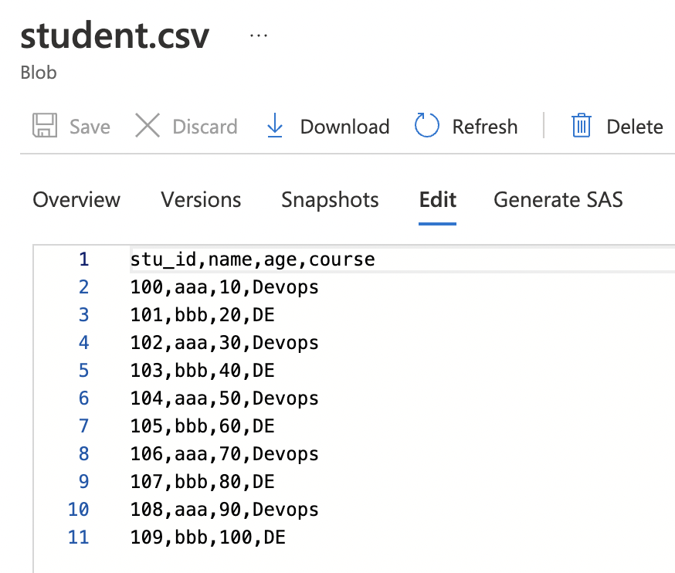
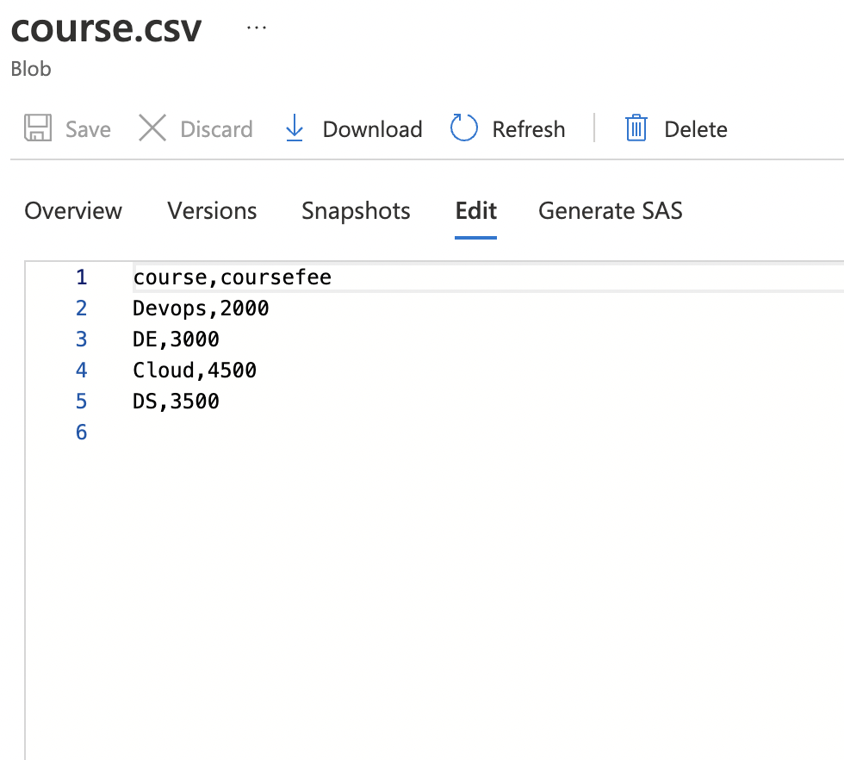
ADF – Transformation Activities

Slide 3
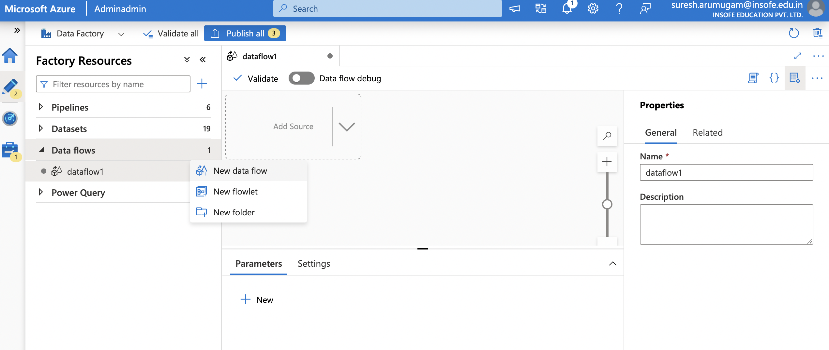
ADF – Transformation Activities

Slide 4
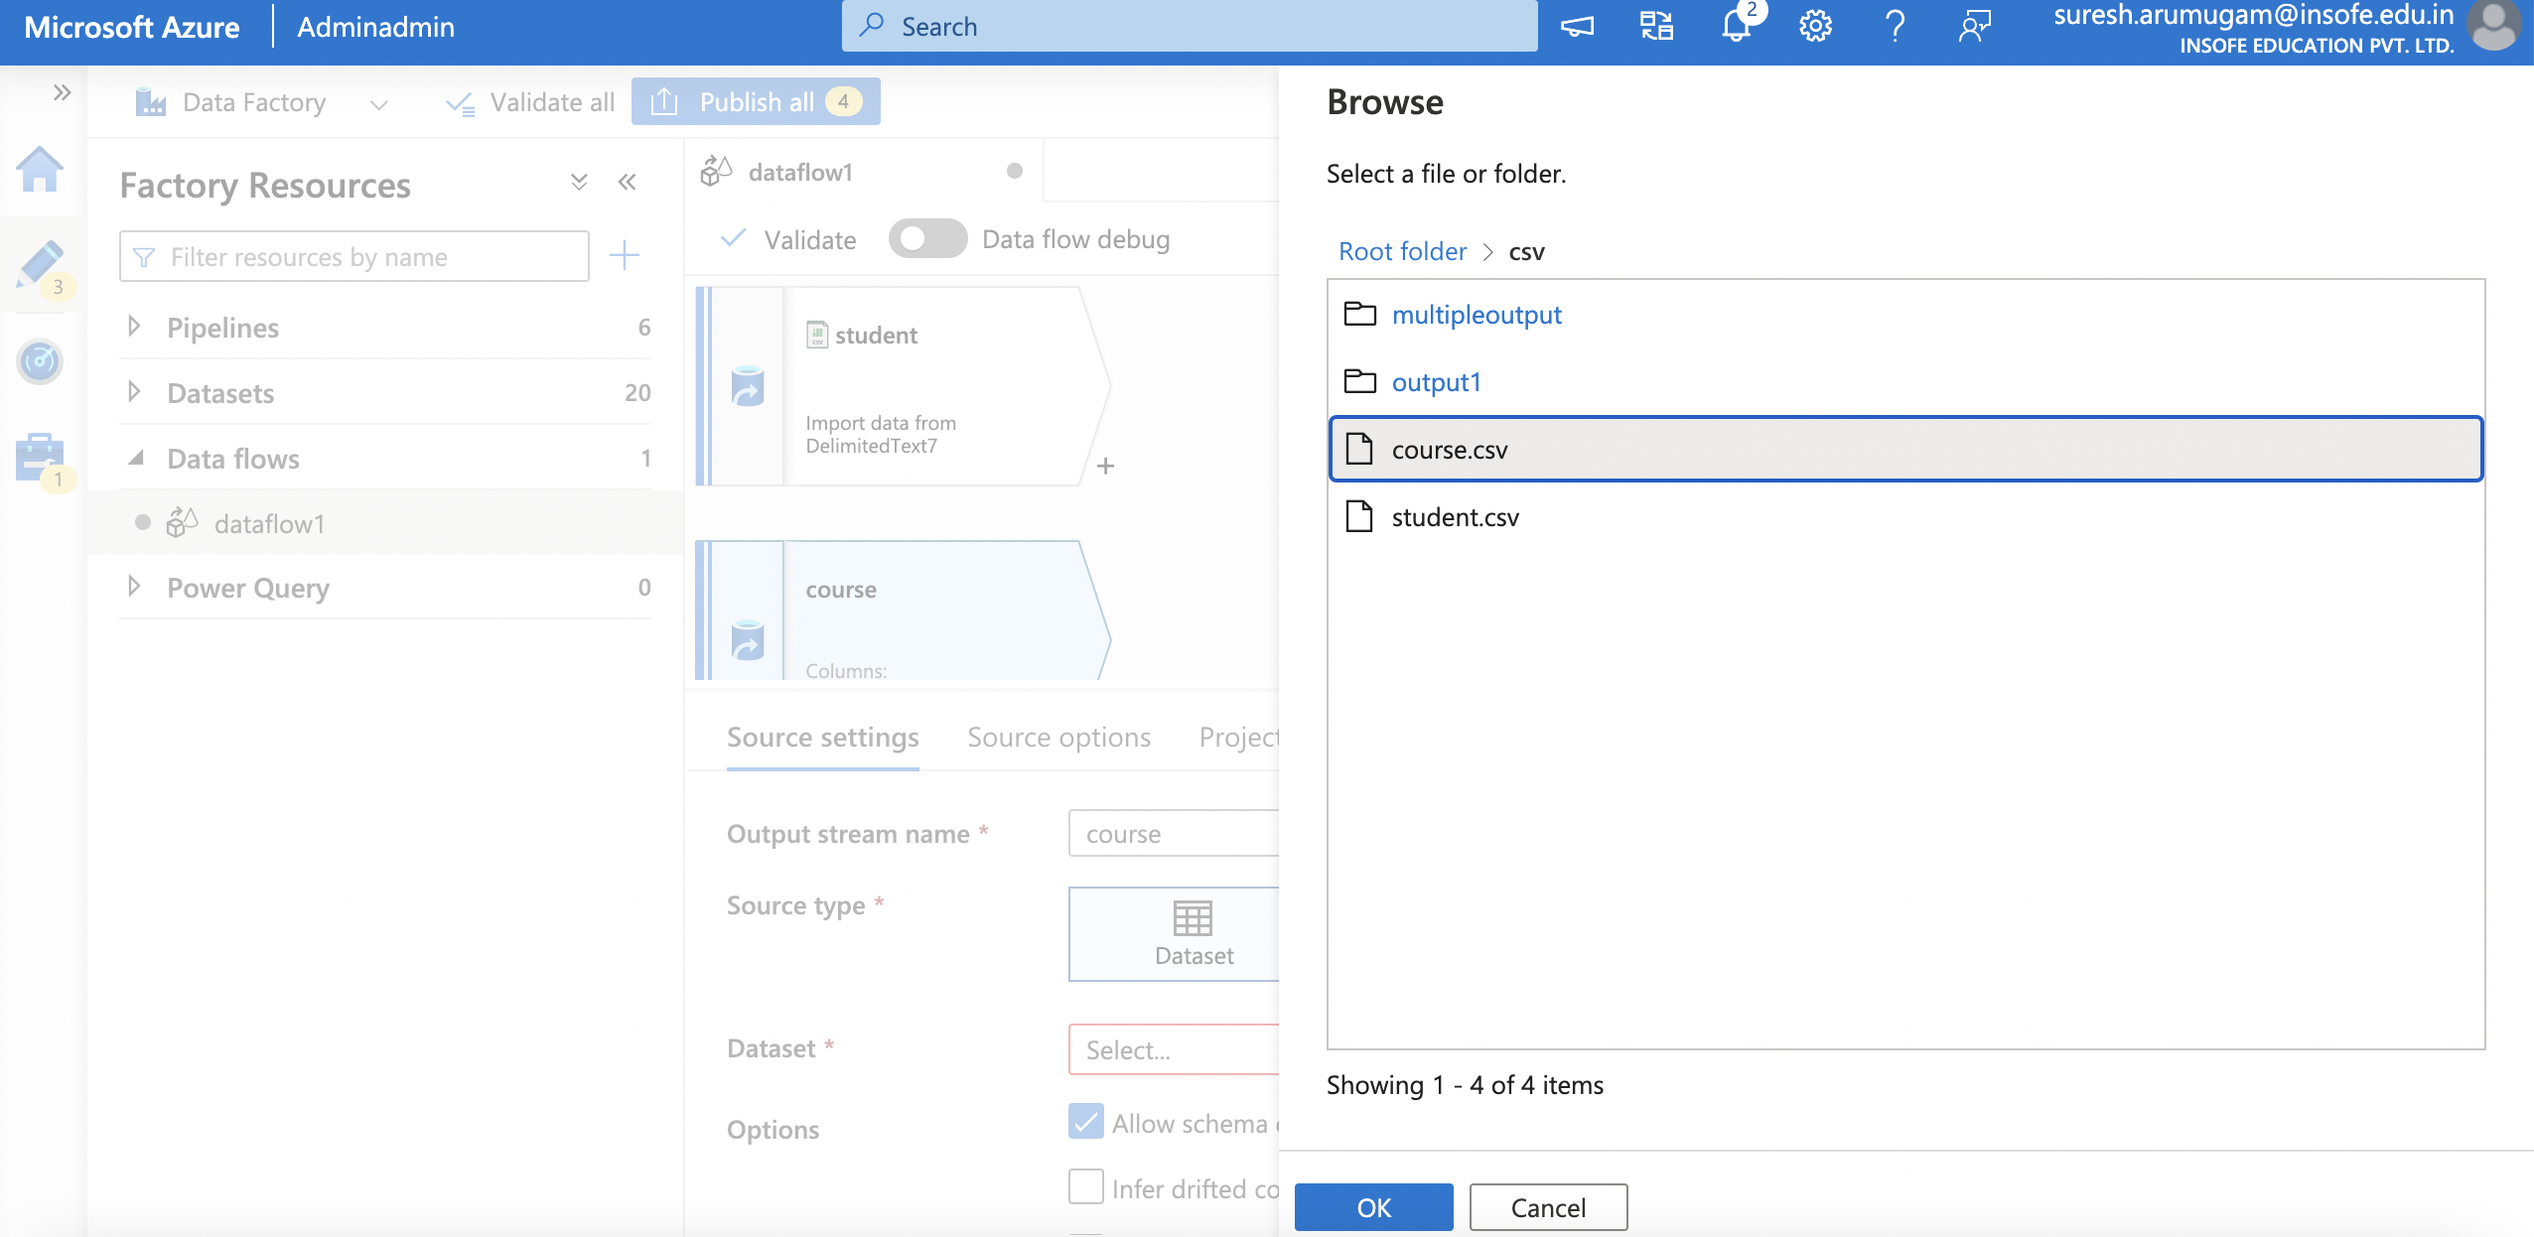
ADF – Transformation Activities

Slide 5
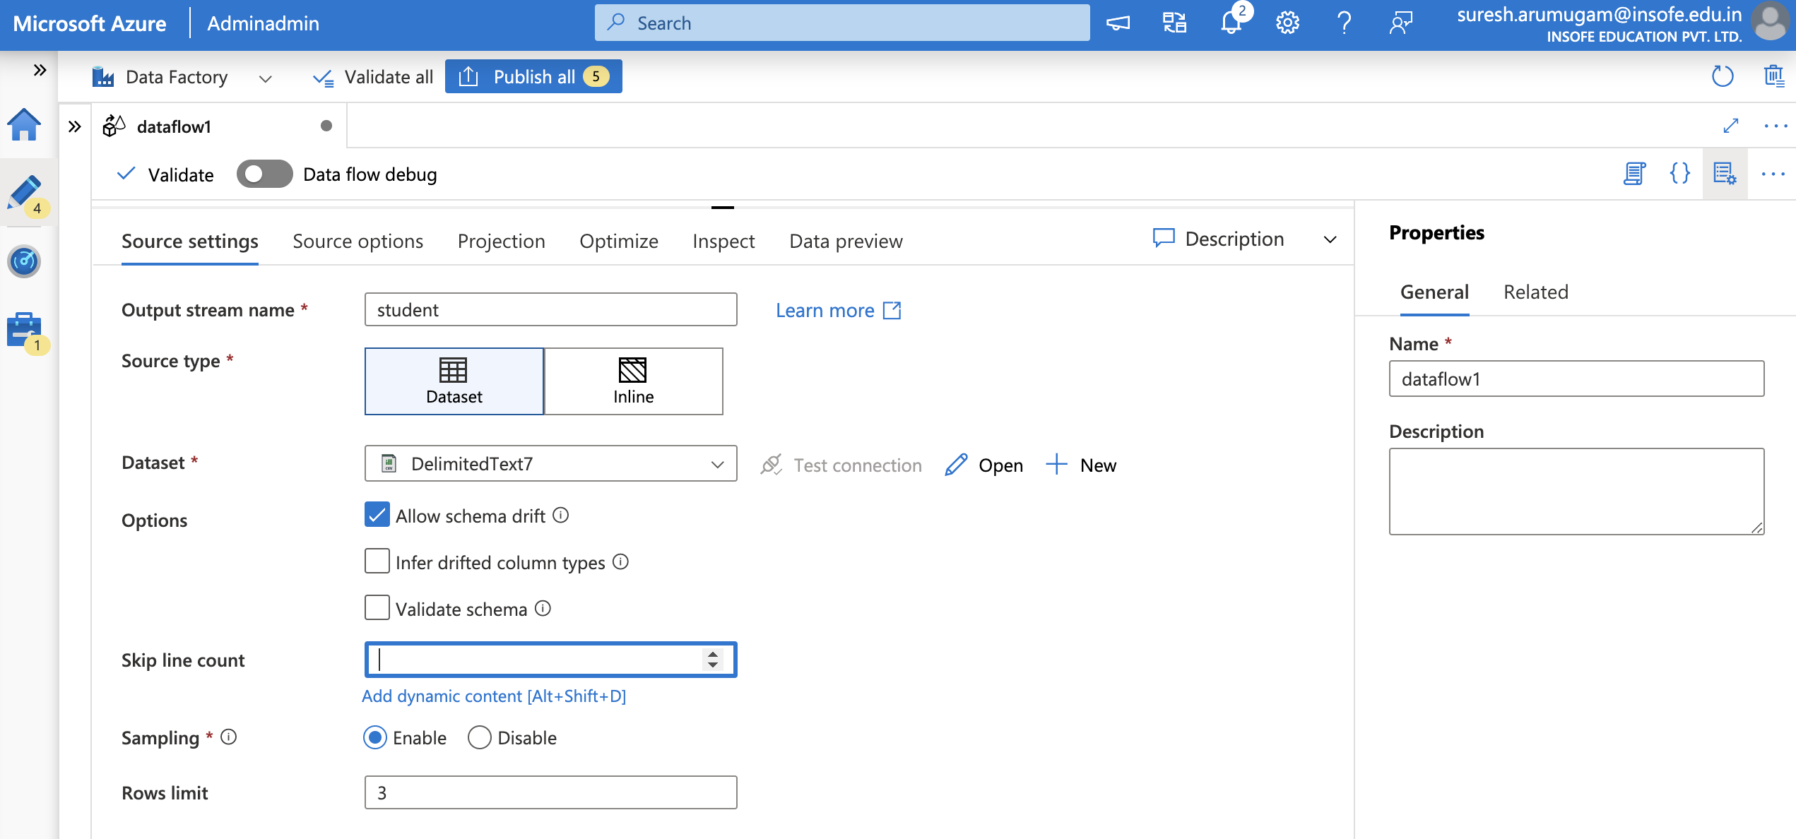
ADF – Transformation Activities

Slide 6
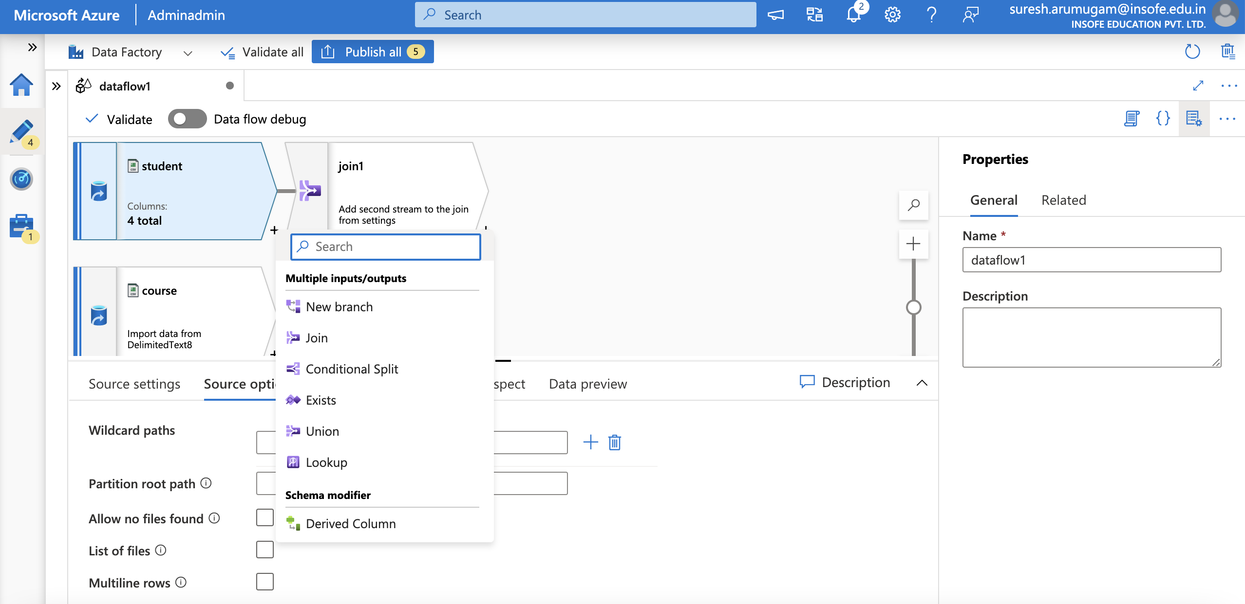
ADF – Transformation Activities

Slide 7
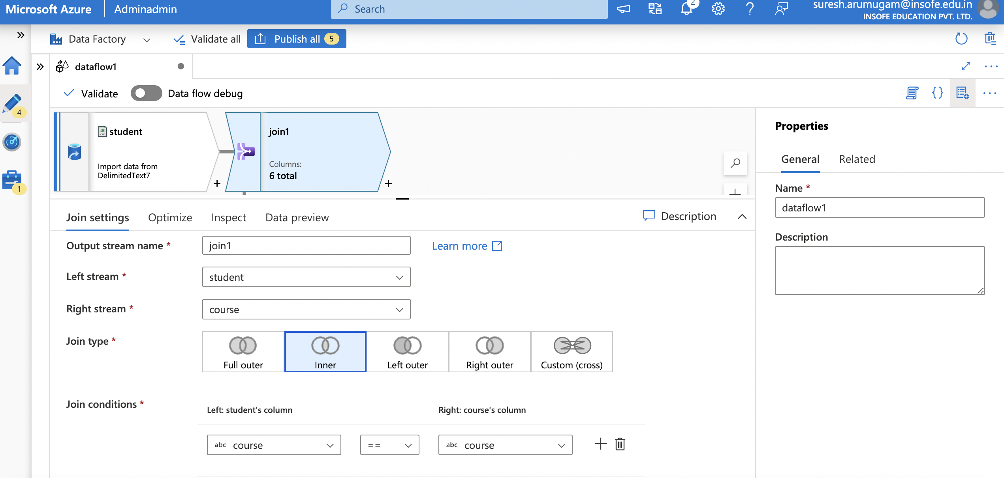
ADF – Transformation Activities

Slide 8
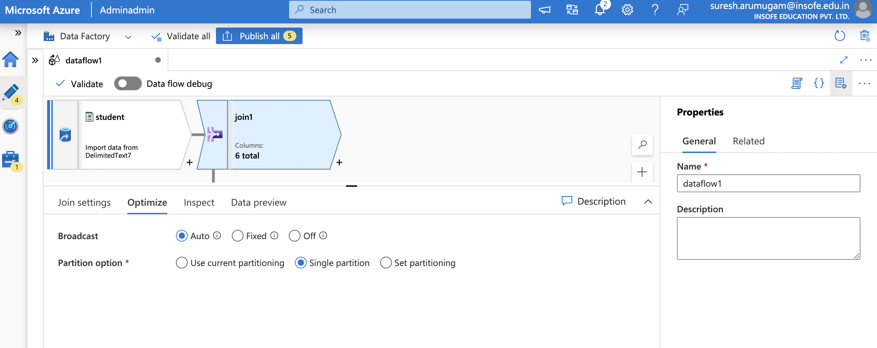
ADF – Transformation Activities

Slide 9
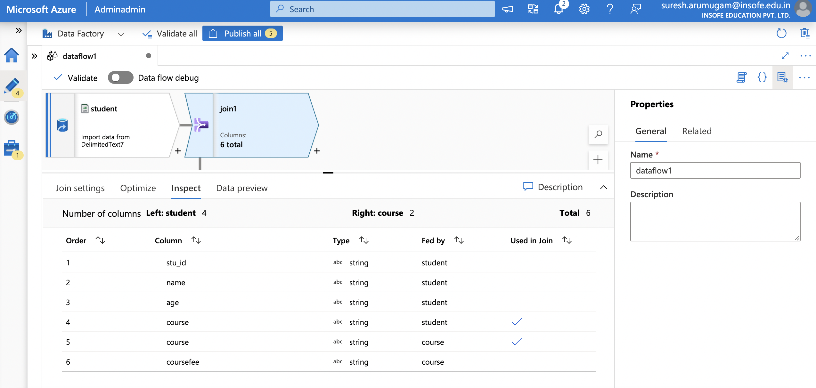
ADF – Transformation Activities

Slide 10
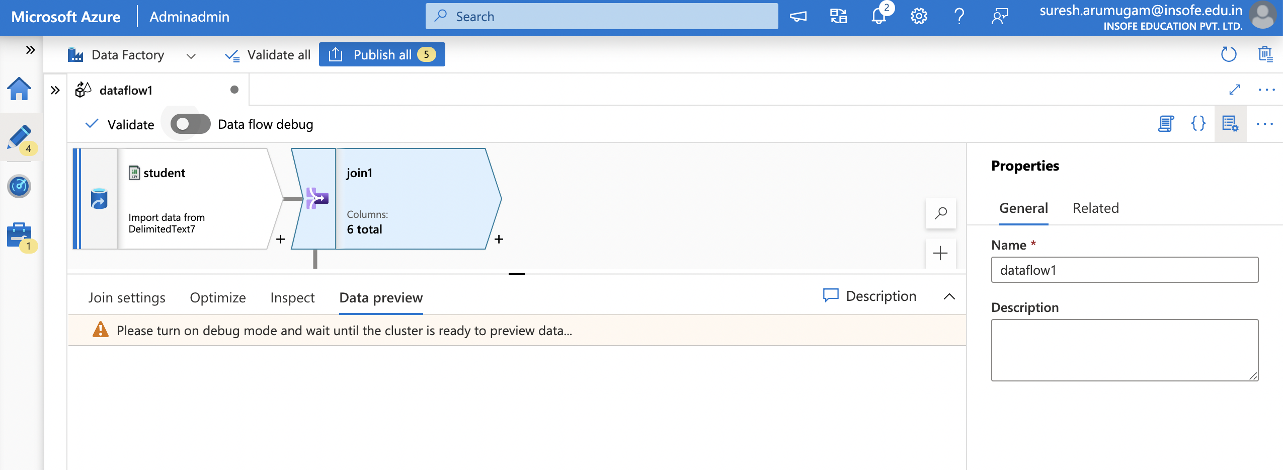
ADF – Transformation Activities

Slide 11
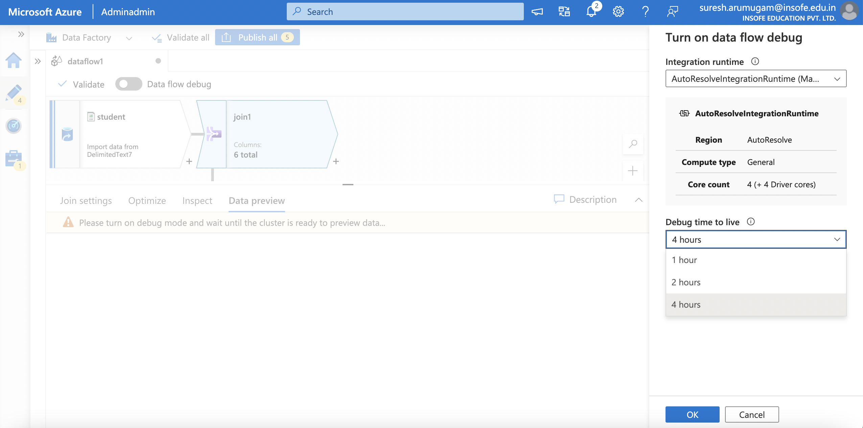
ADF – Transformation Activities

Slide 12
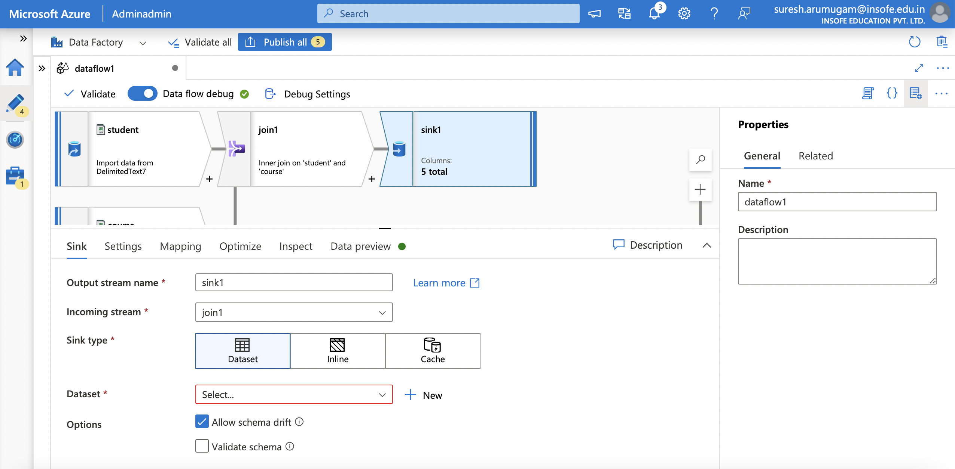
ADF – Transformation Activities

Slide 13
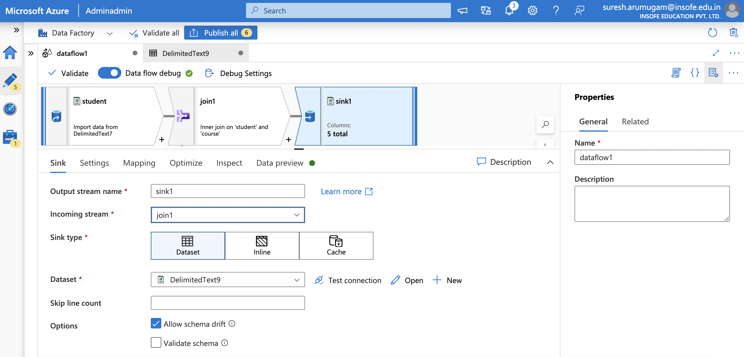
ADF – Transformation Activities

Slide 14
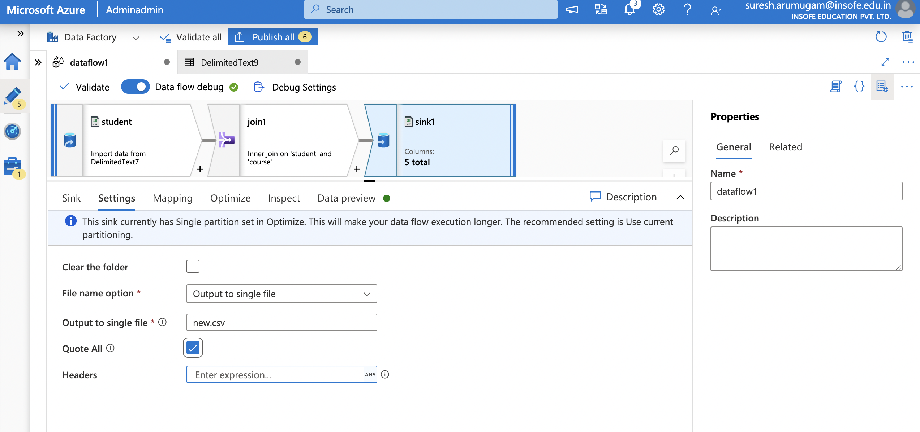
ADF – Transformation Activities

Slide 15
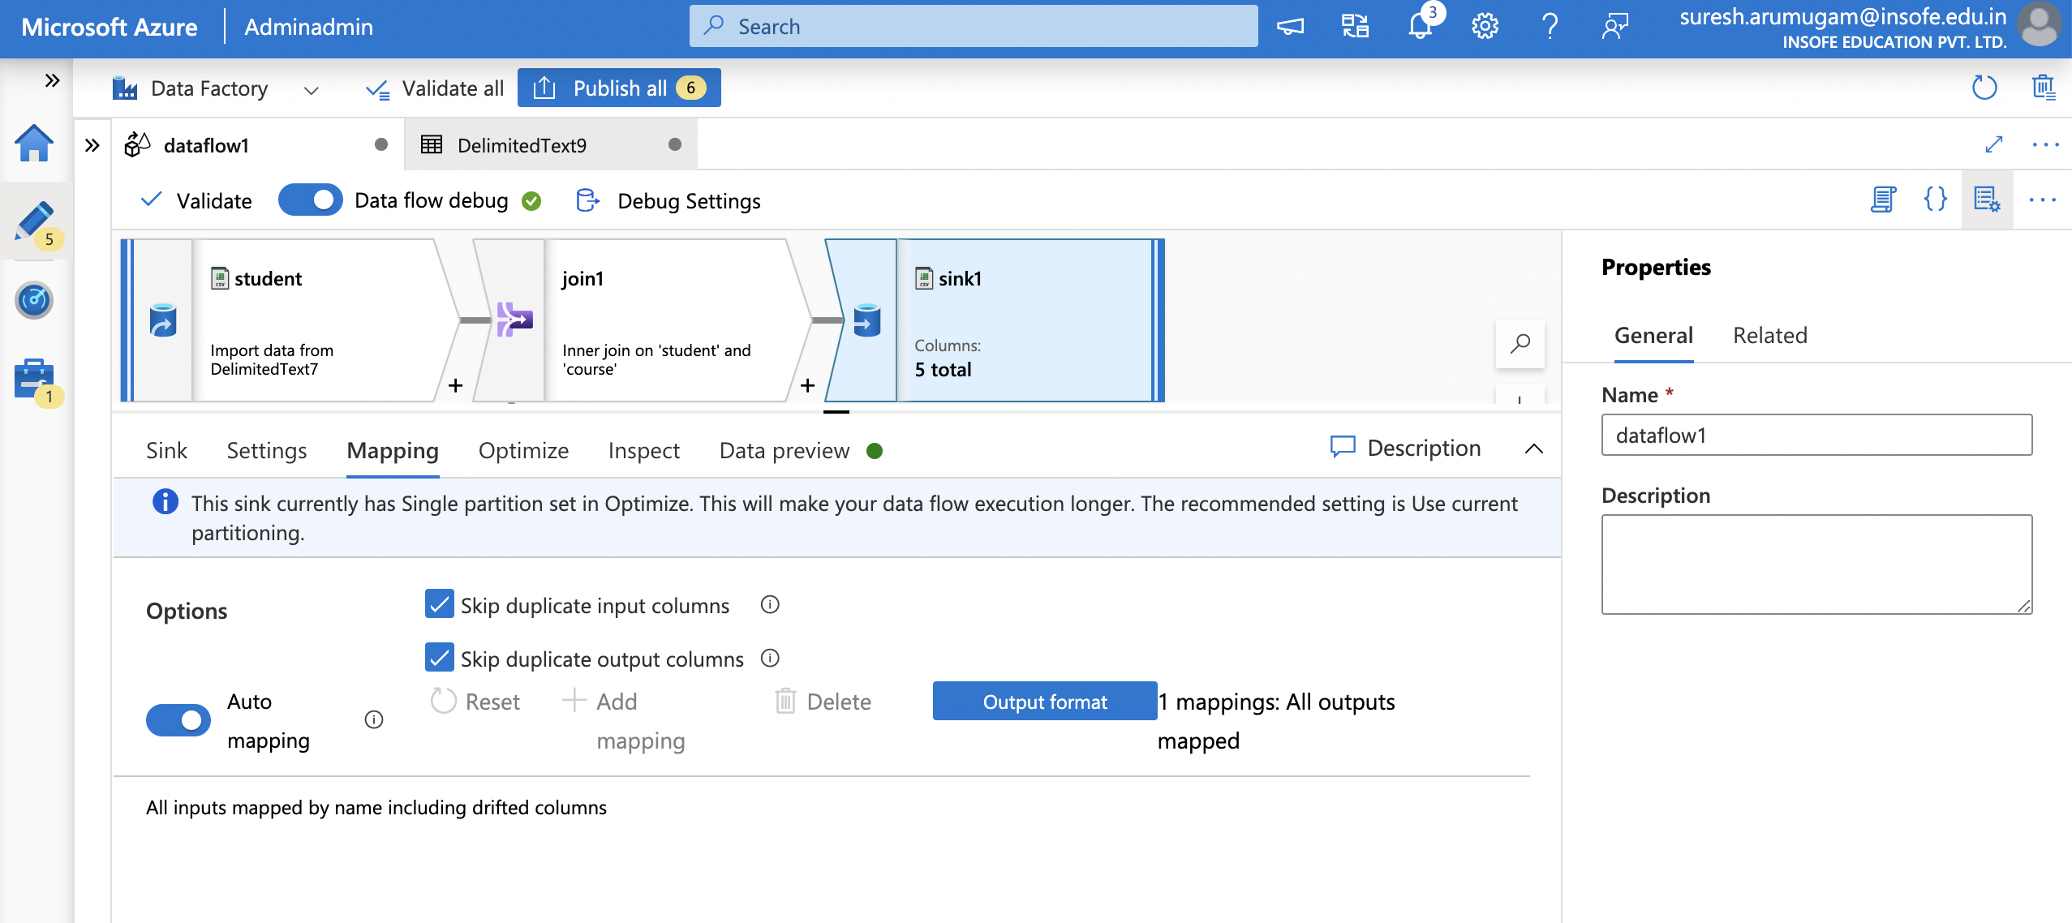
ADF – Transformation Activities

Slide 16
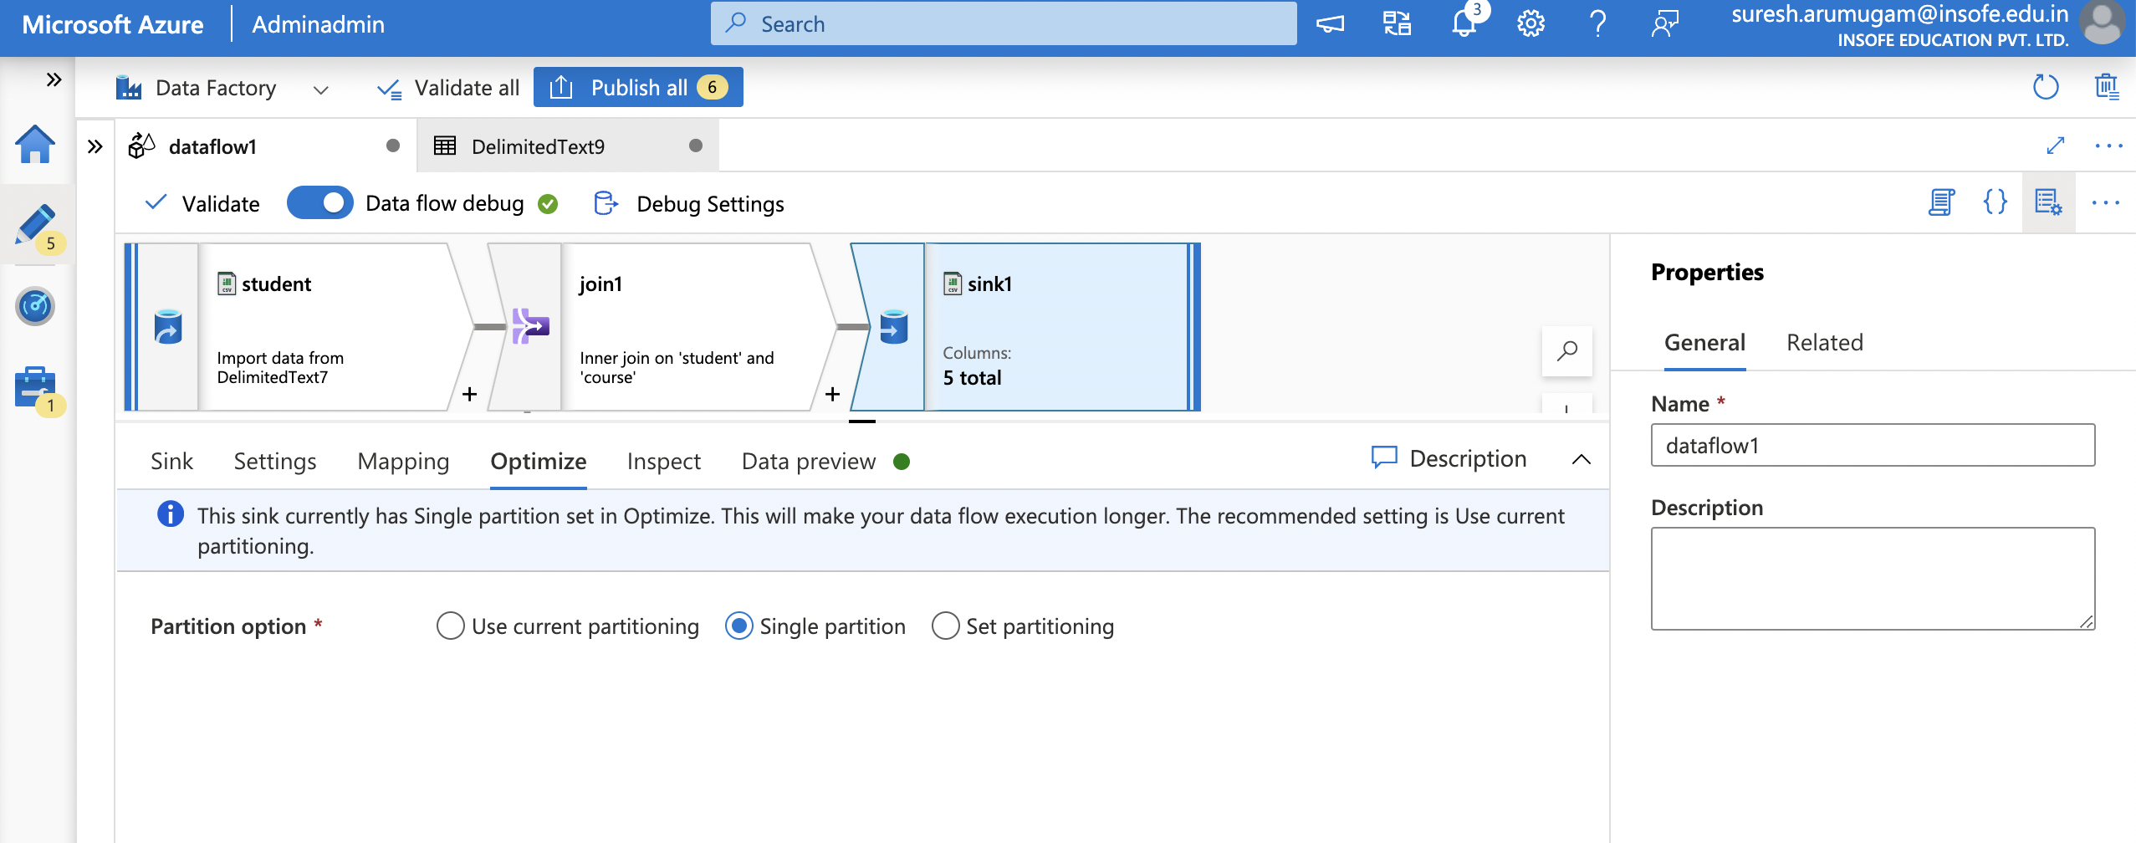
ADF – Transformation Activities

Slide 17
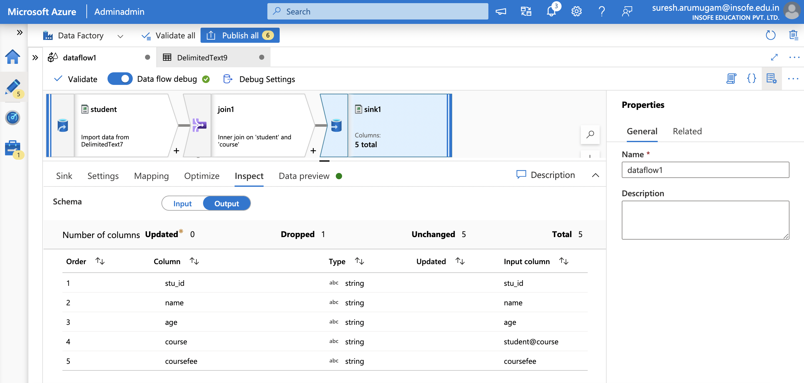
ADF – Transformation Activities

Slide 18
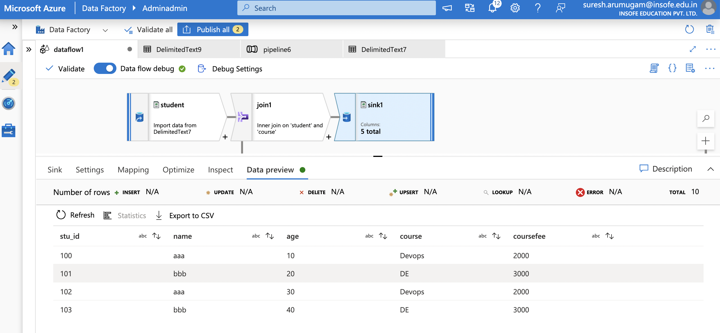
ADF – Transformation Activities

Slide 19
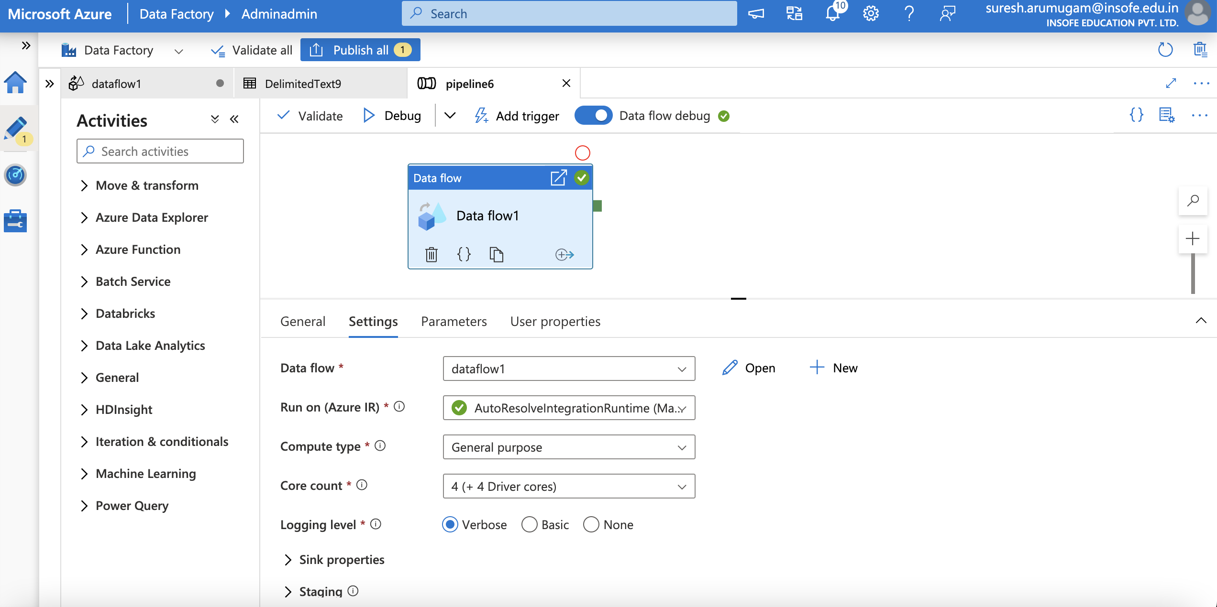
ADF – Transformation Activities

Slide 20
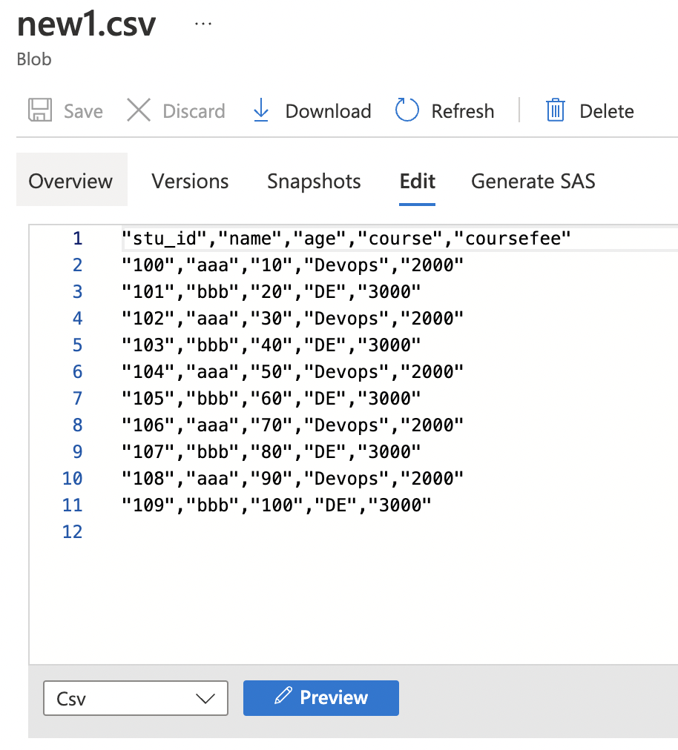
ADF – Transformation Activities

Slide 21
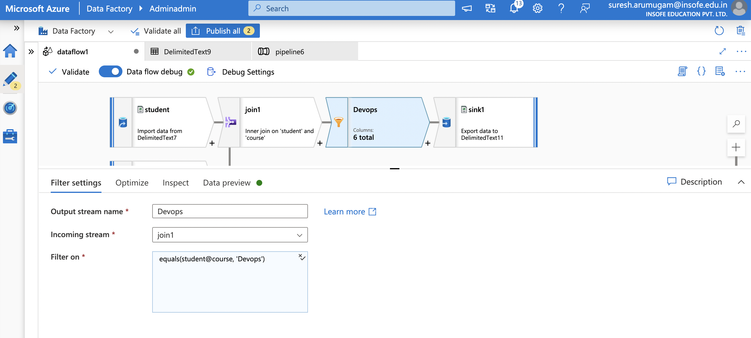
ADF – Transformation Activities

Slide 22
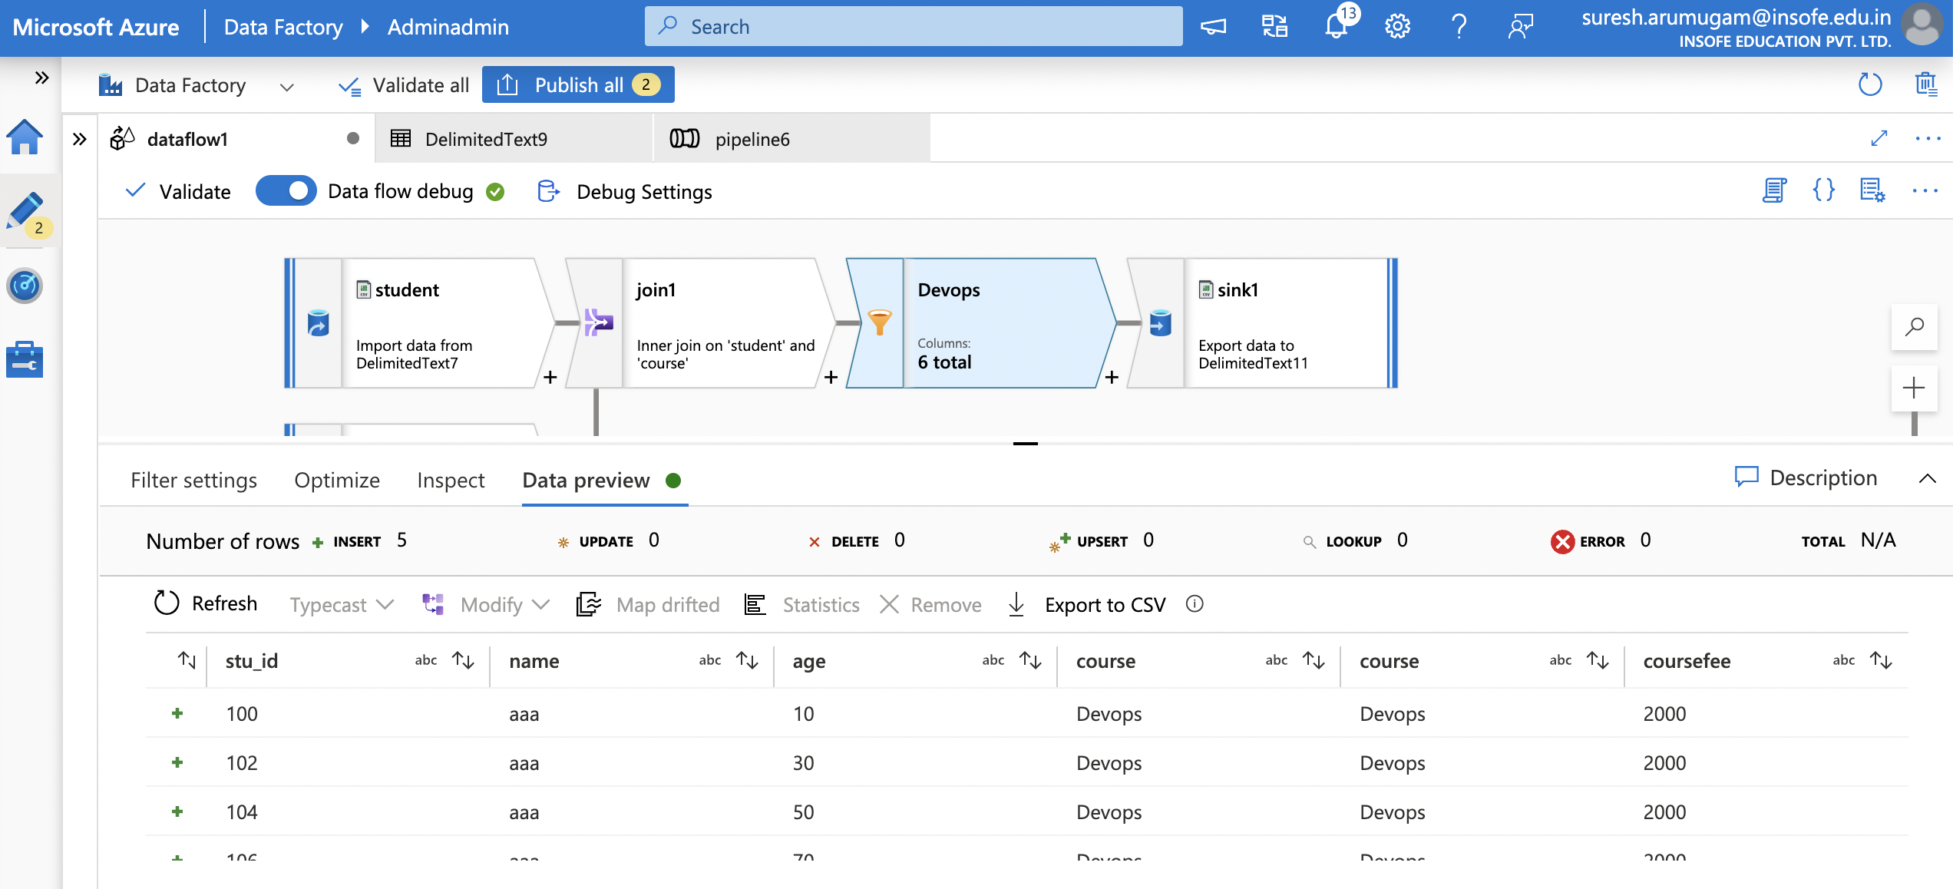
ADF – Transformation Activities

Slide 23
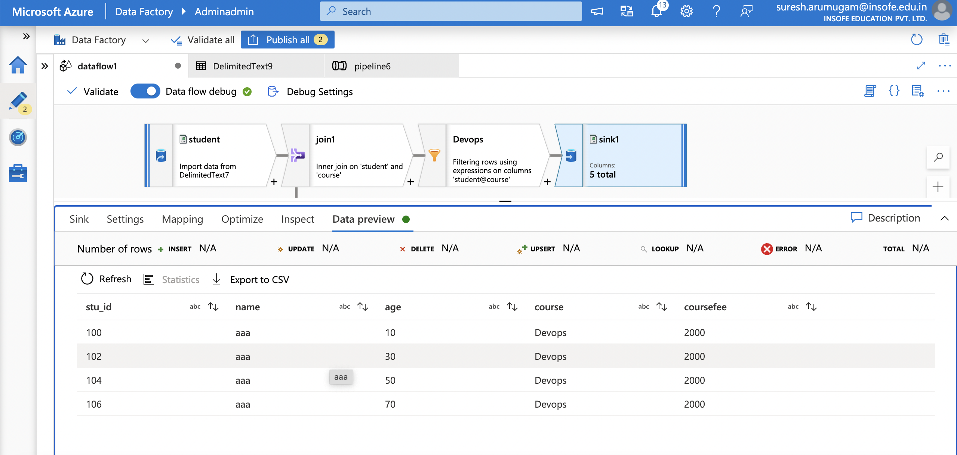
ADF – Transformation Activities

Slide 24
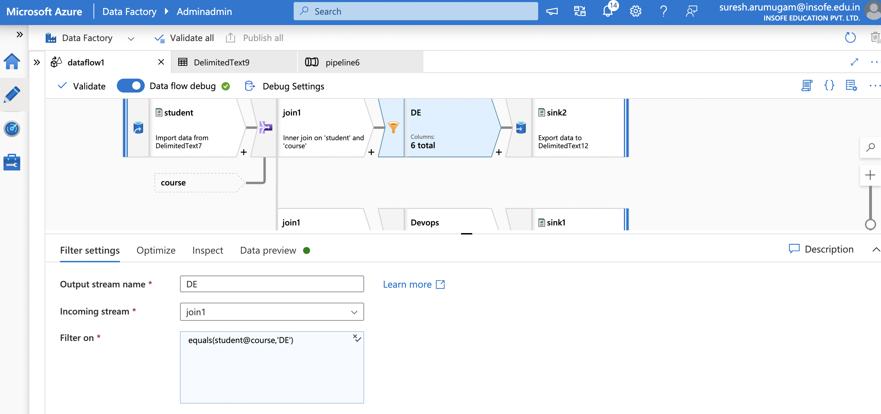
ADF – Transformation Activities

Slide 25
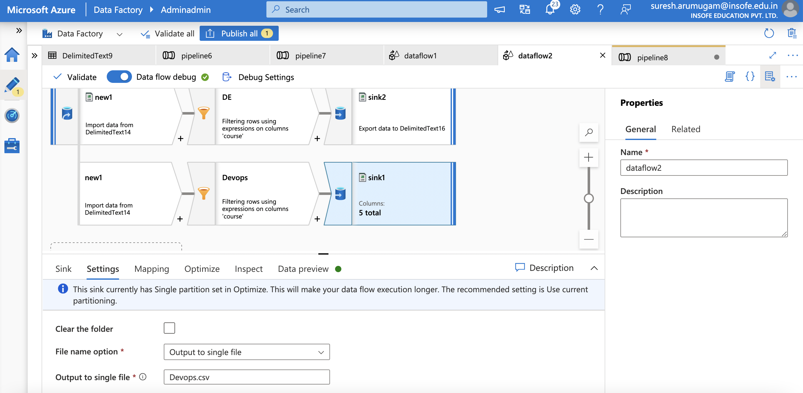
ADF – Transformation Activities

Slide 26
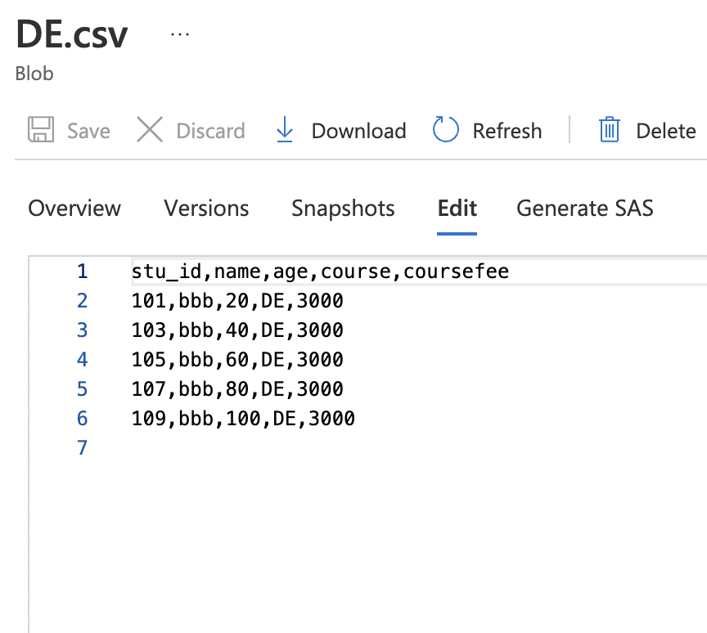
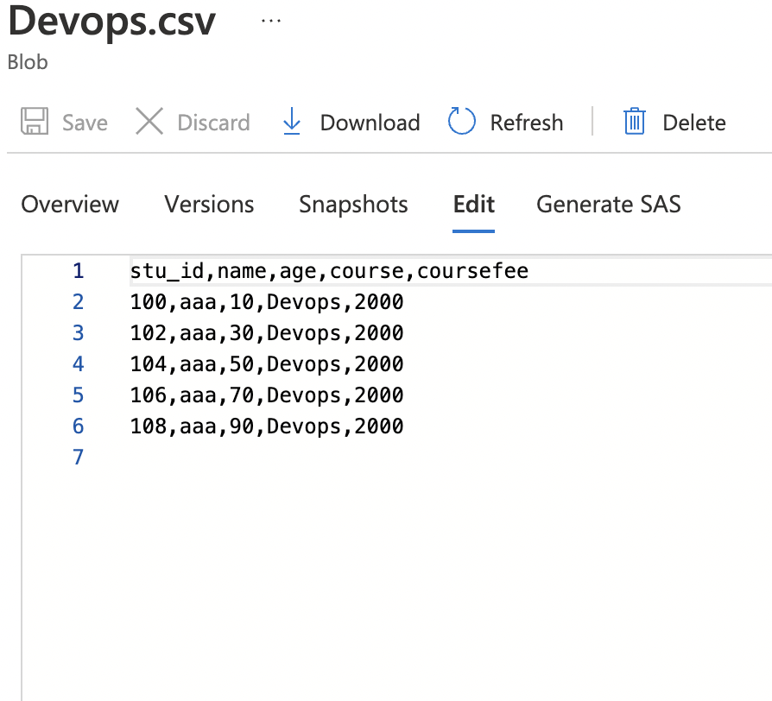
ADF – Transformation Activities

Slide 27
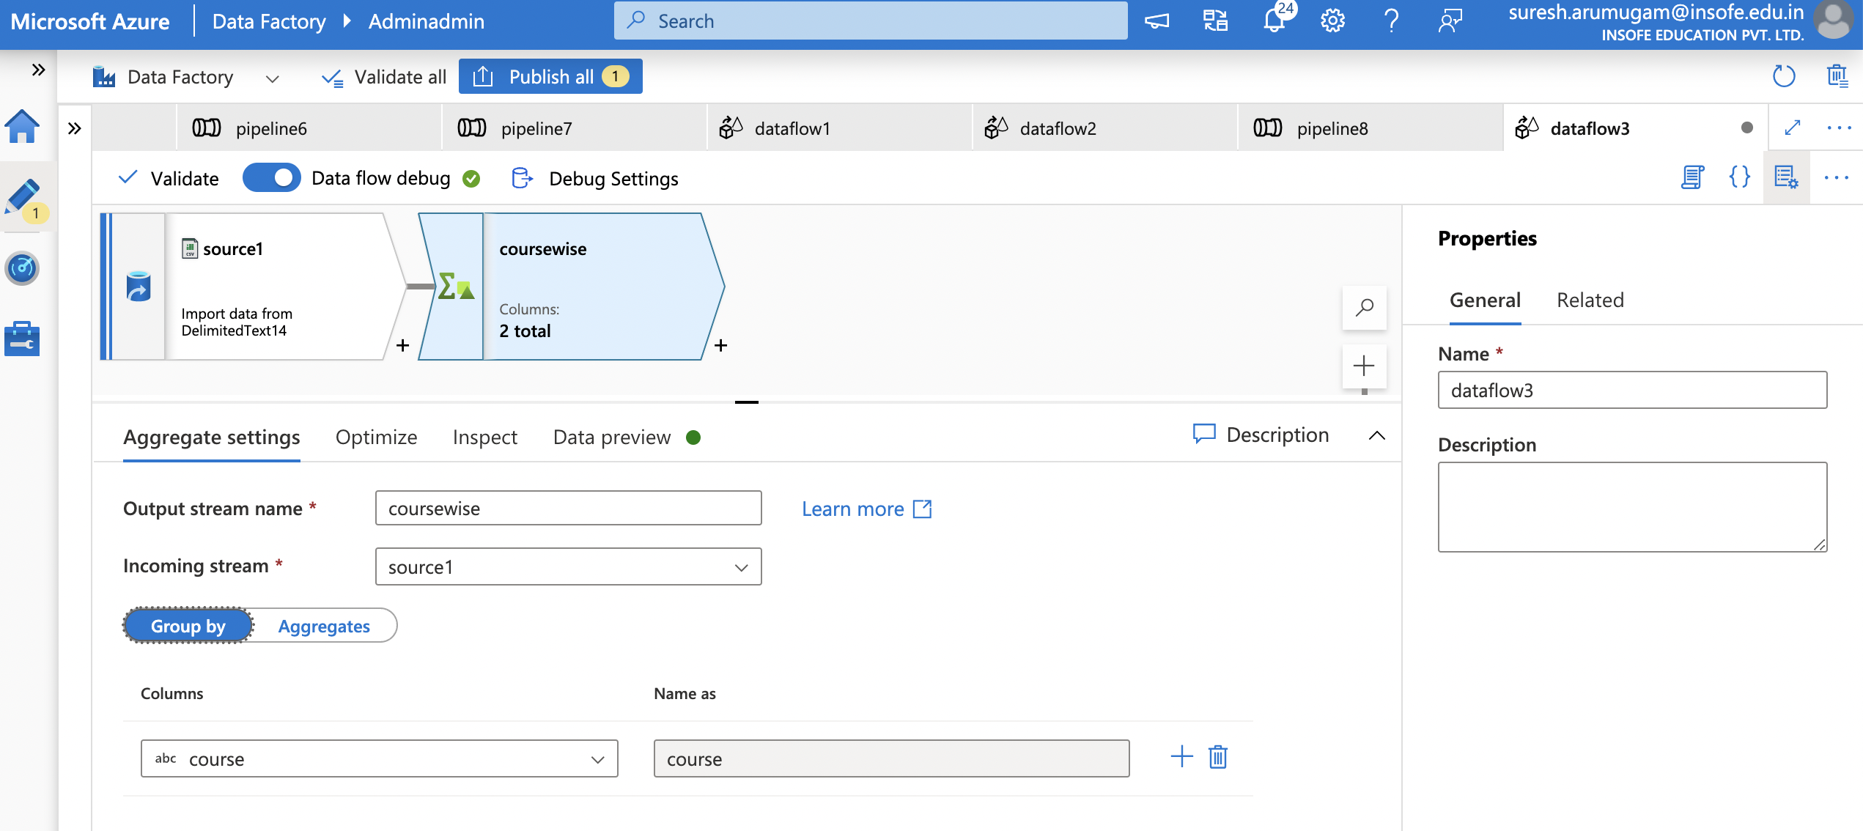
ADF – Transformation Activities

Slide 28
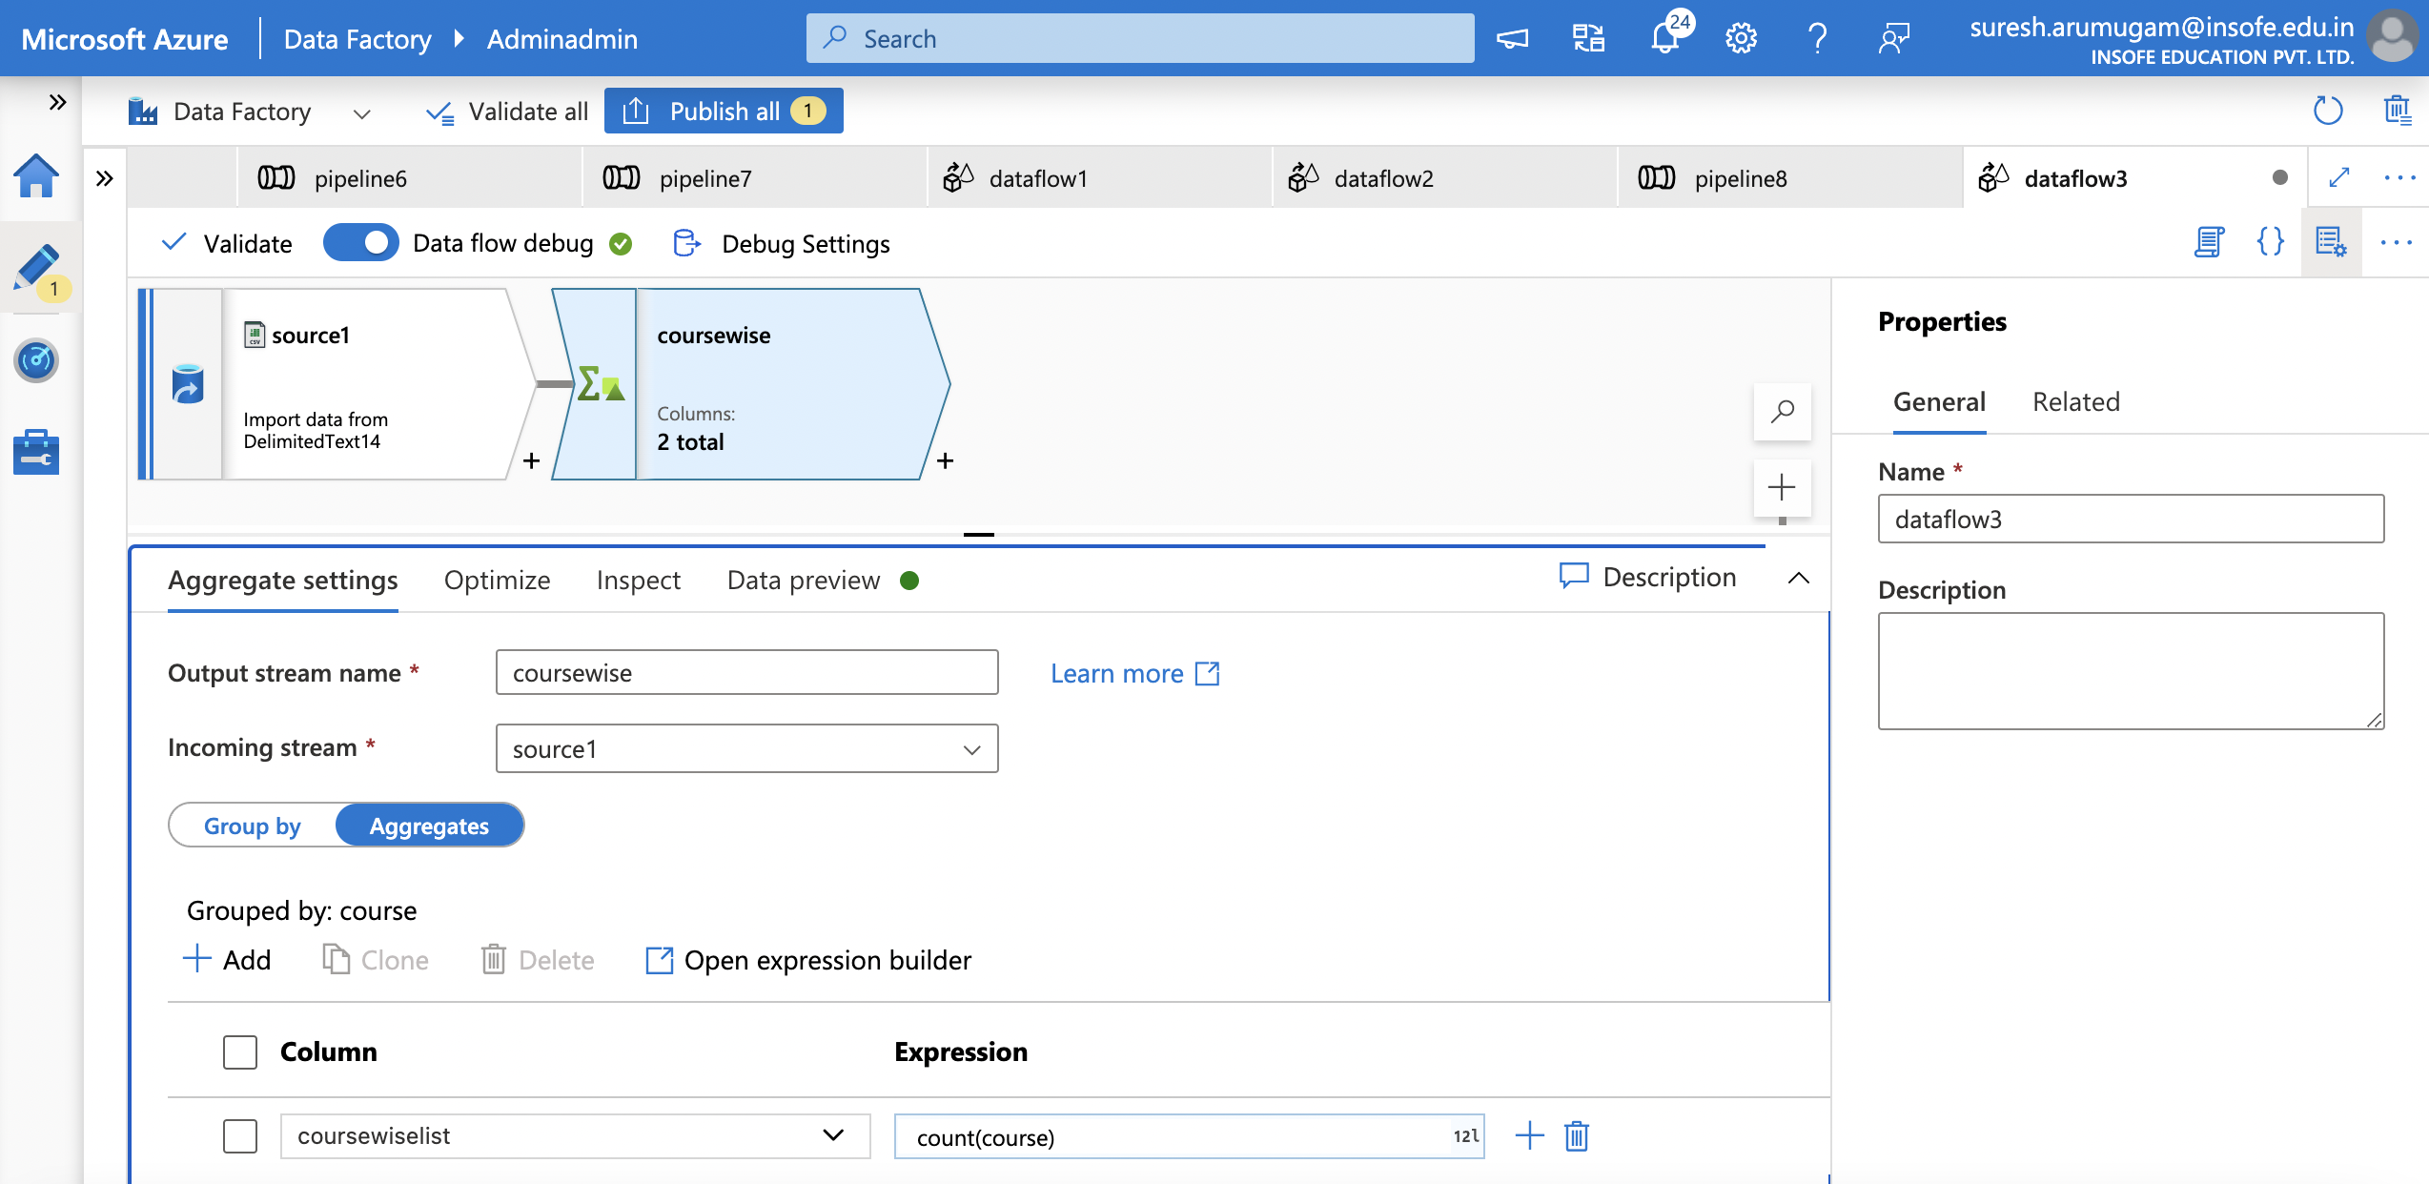
ADF – Transformation Activities

Slide 29
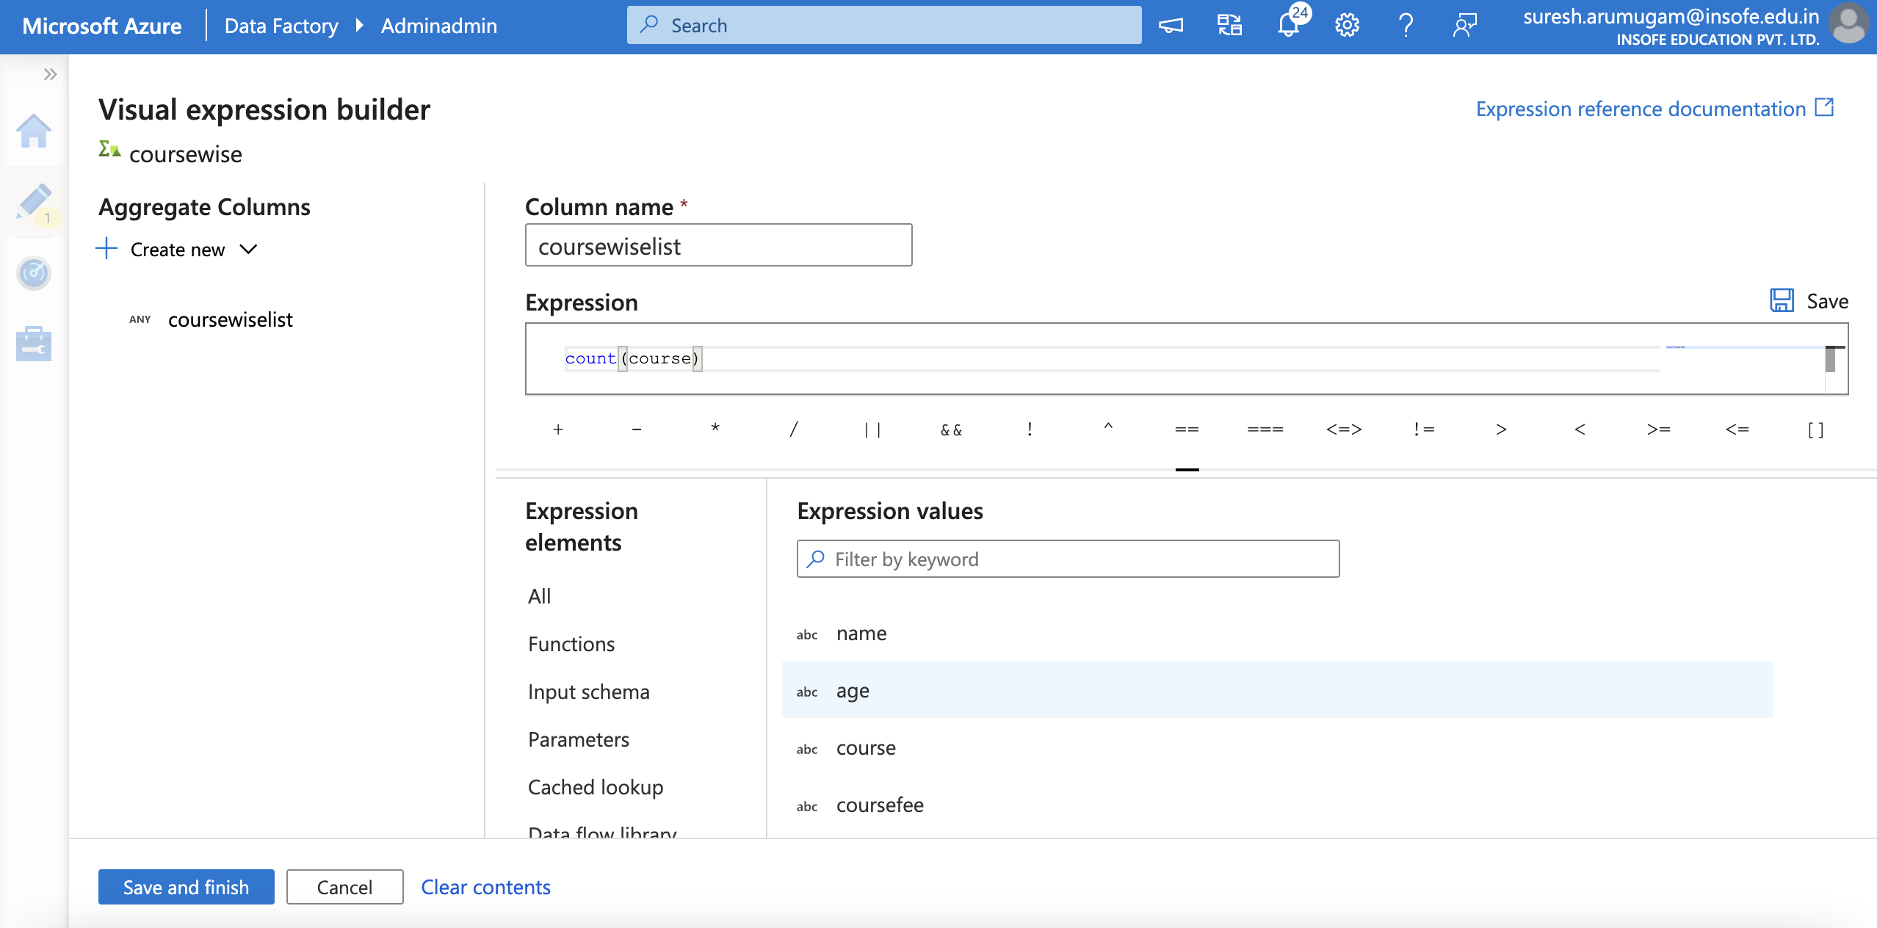
ADF – Transformation Activities

Slide 30
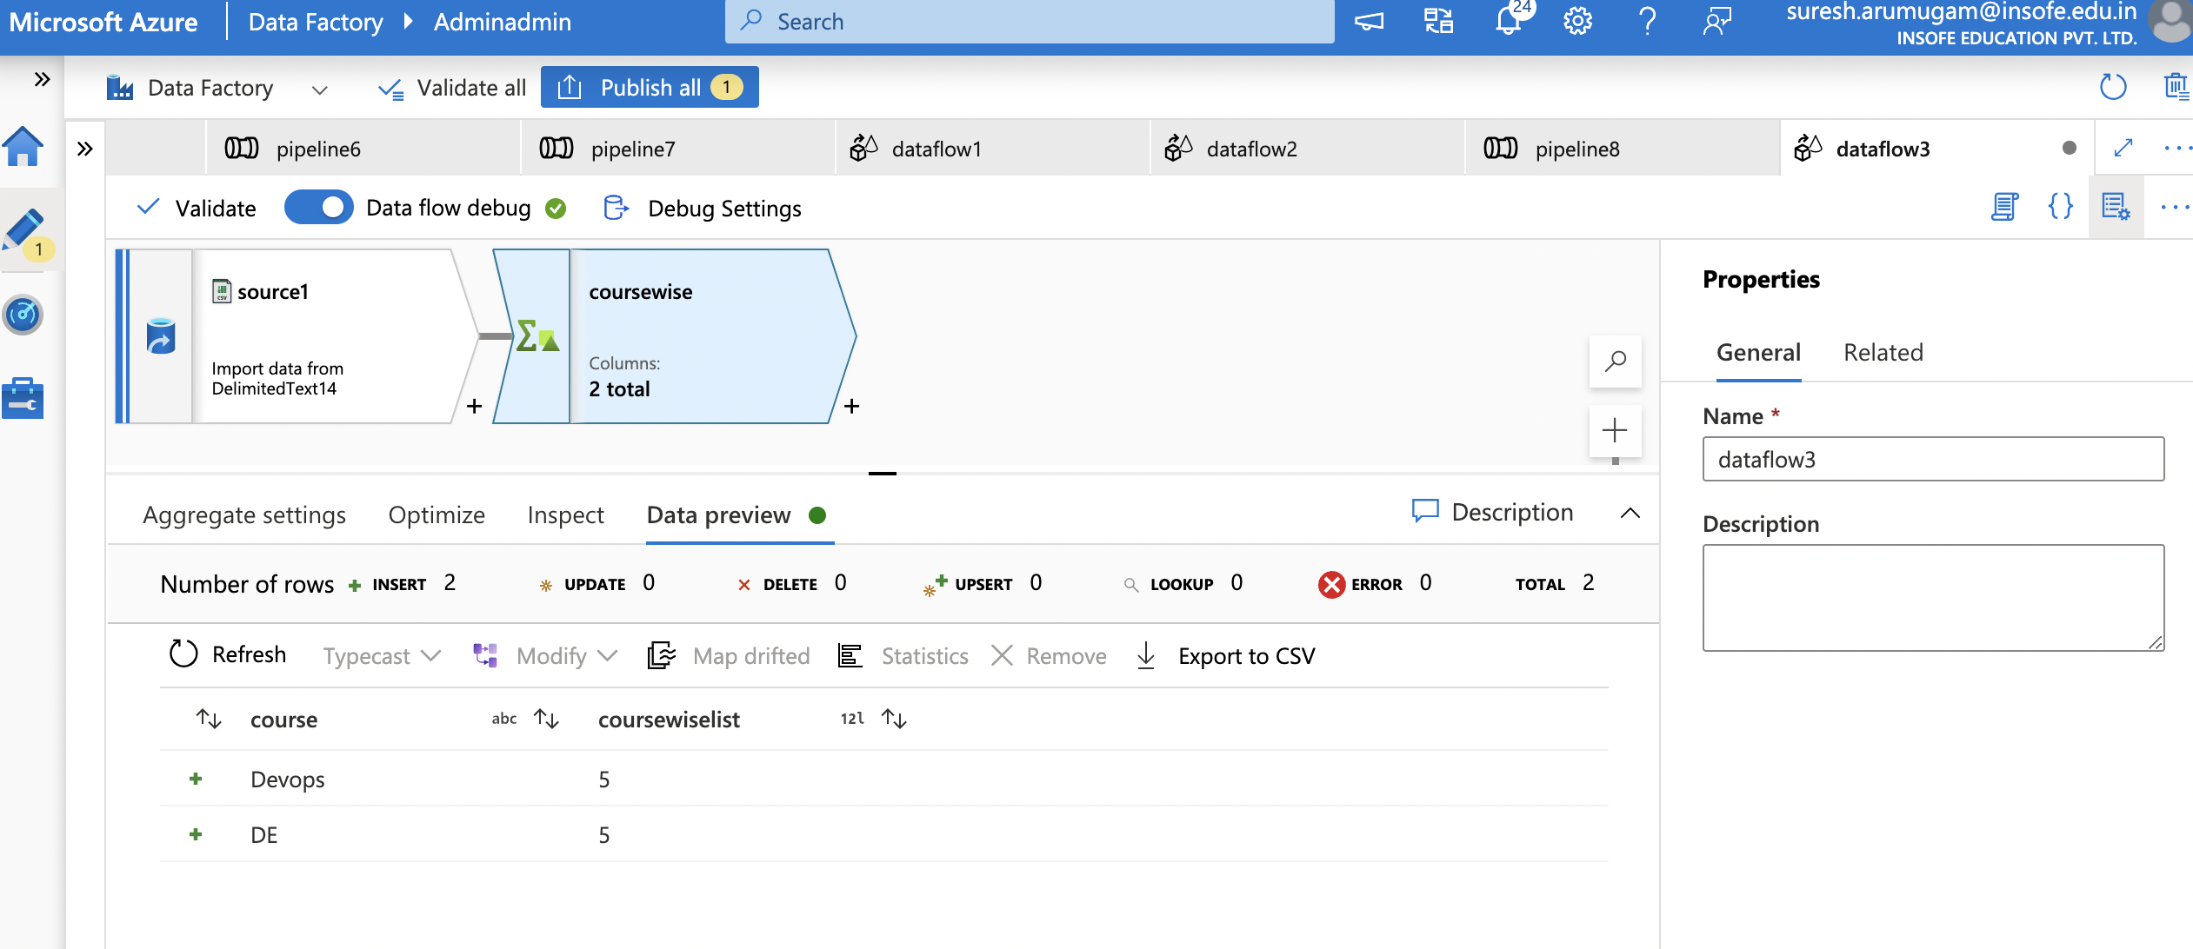
ADF – Transformation Activities

Slide 31
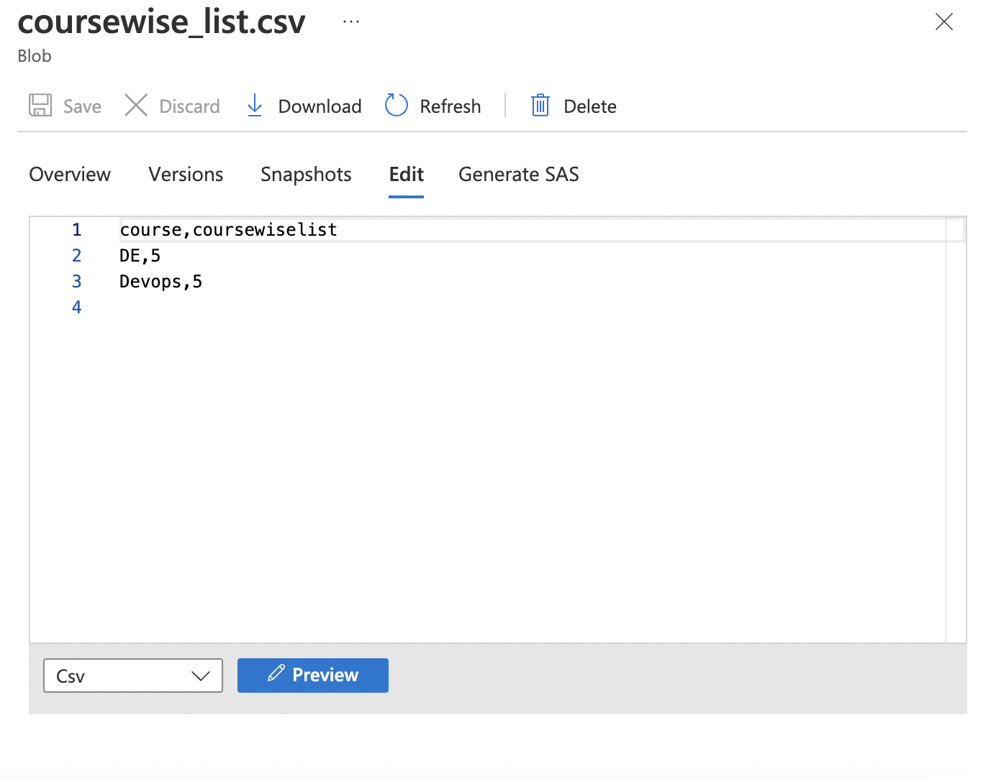
ADF – Transformation Activities

Slide 32
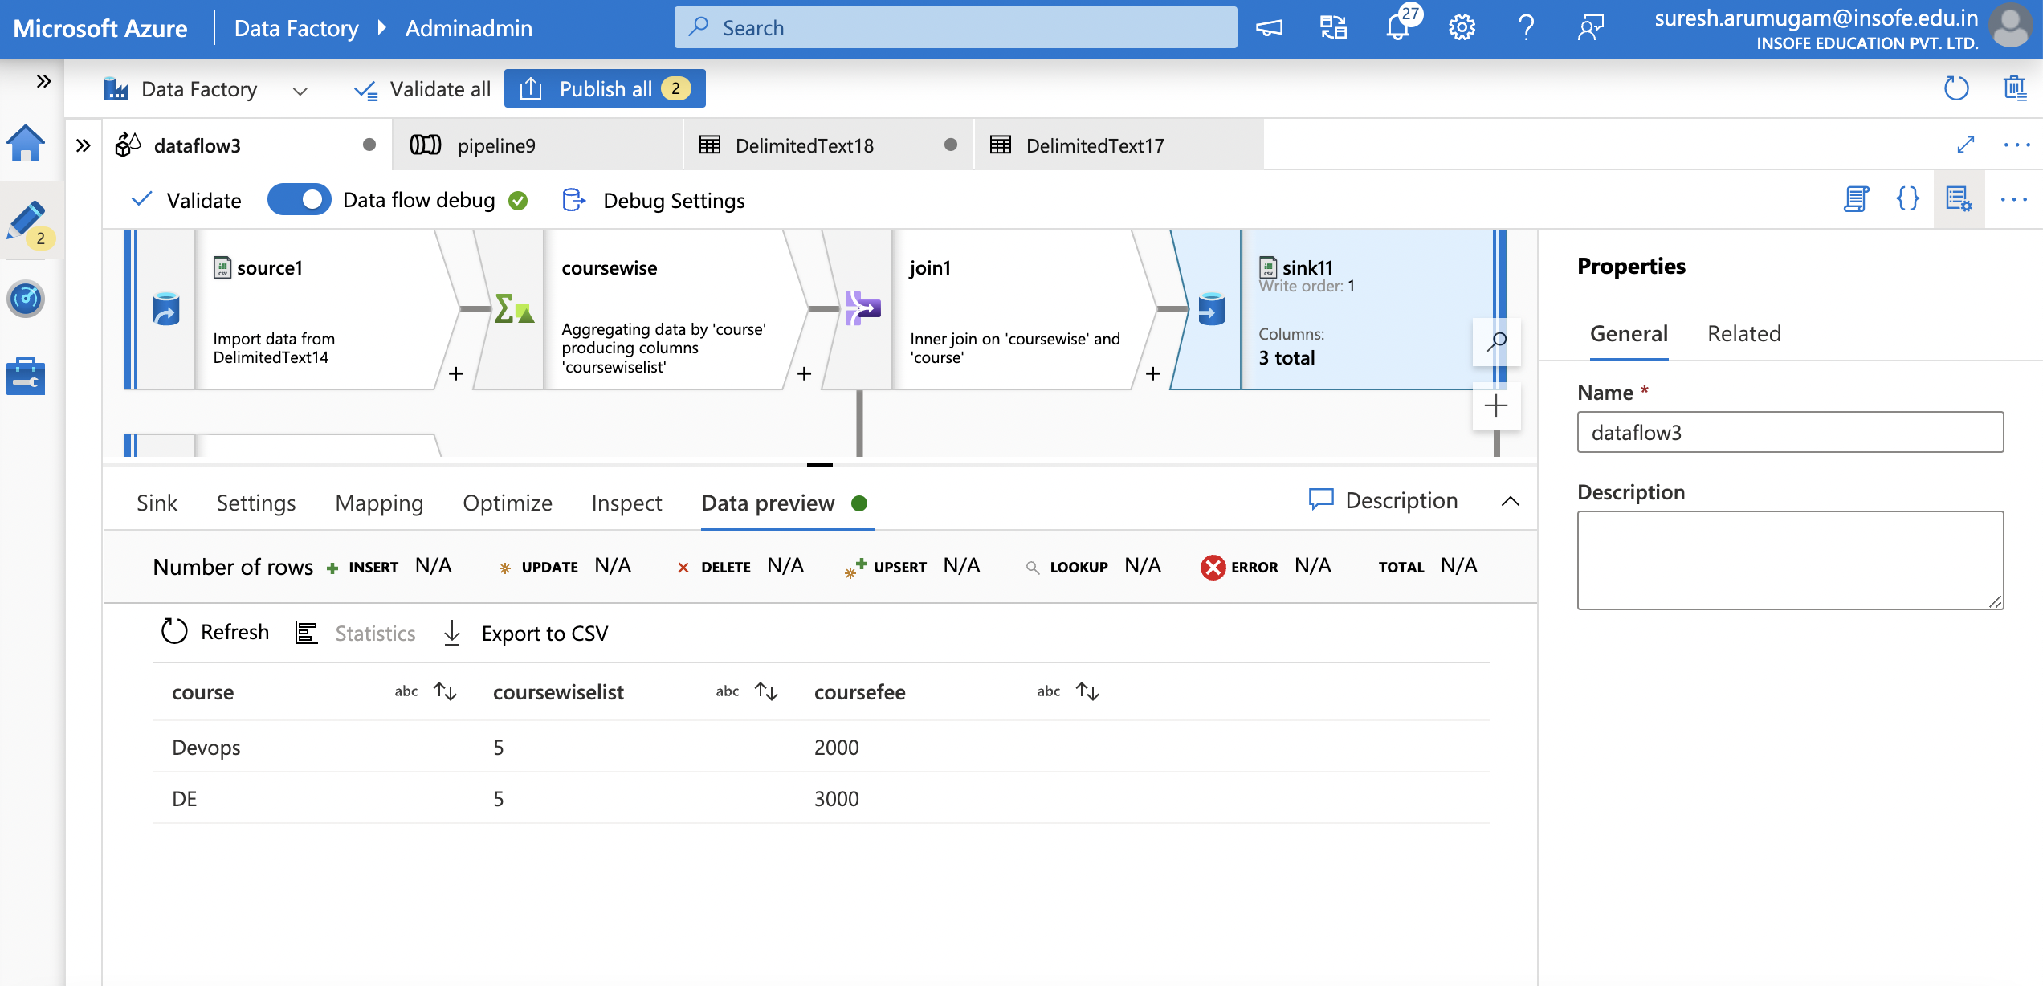
ADF – Transformation Activities

Slide 33
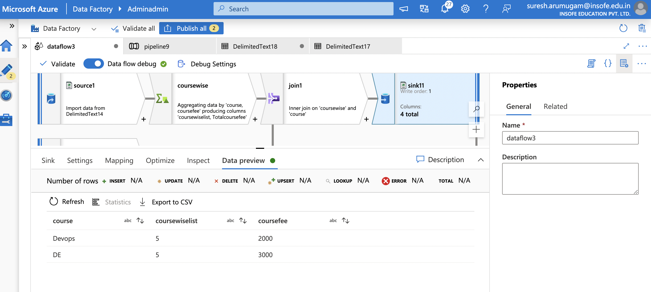
ADF – Transformation Activities

Slide 34
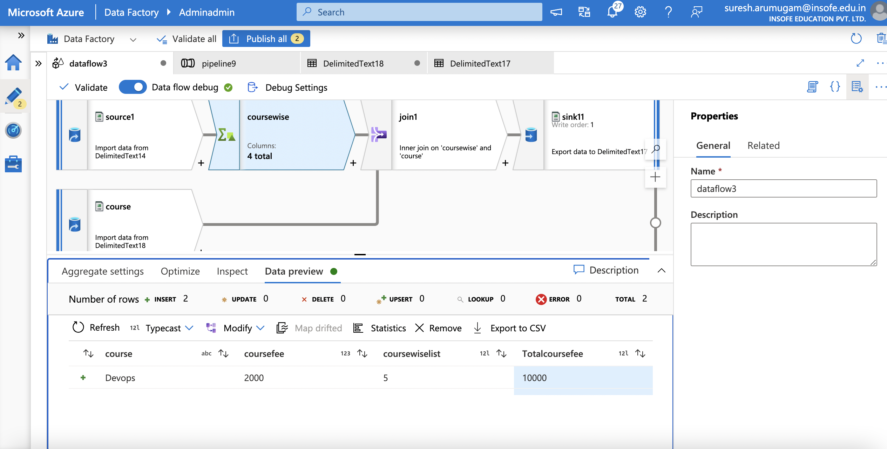
ADF – Transformation Activities

Slide 35
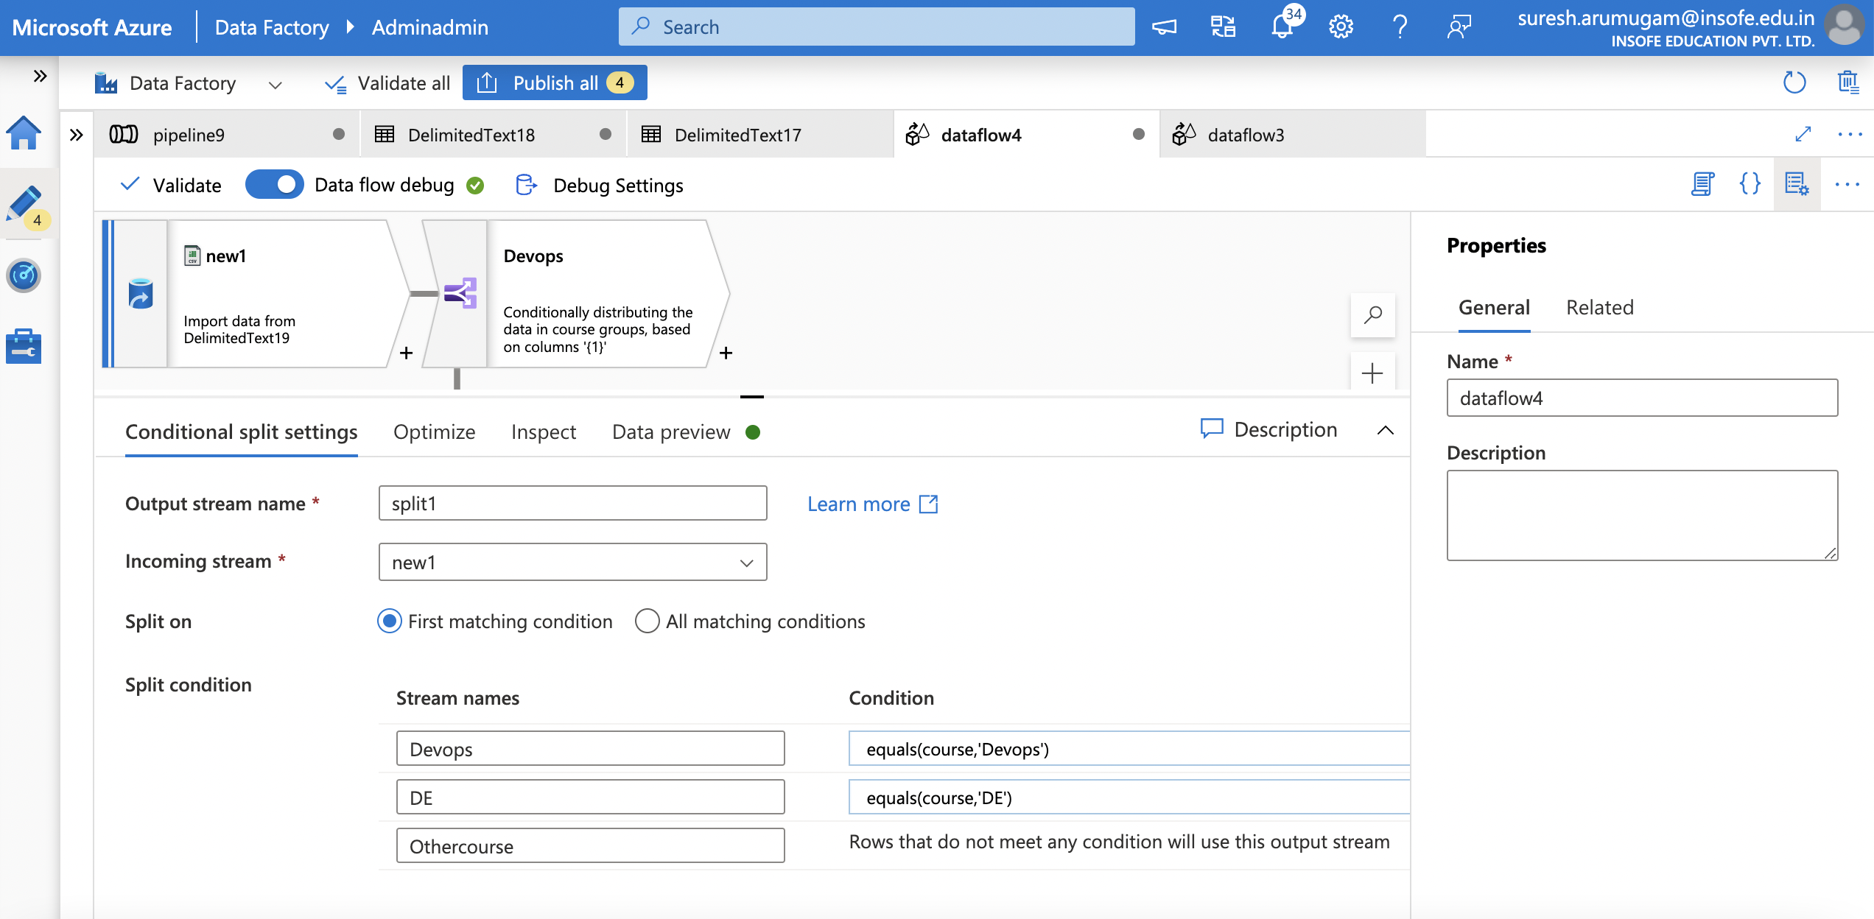
ADF – Transformation Activities

Slide 36
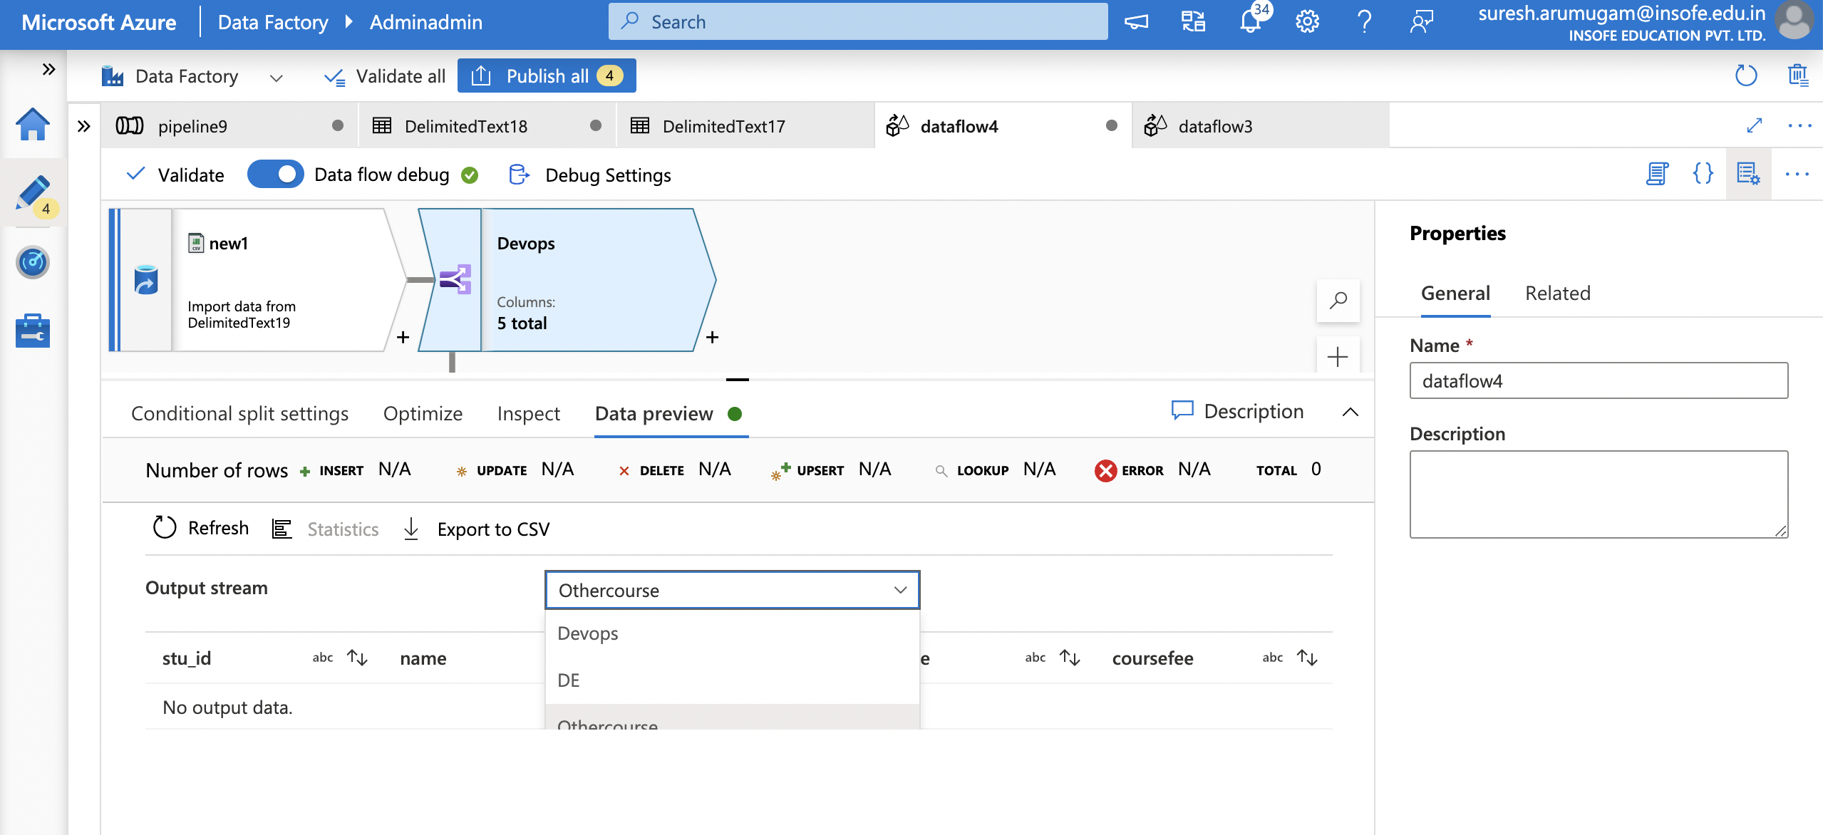
ADF – Transformation Activities

Slide 37
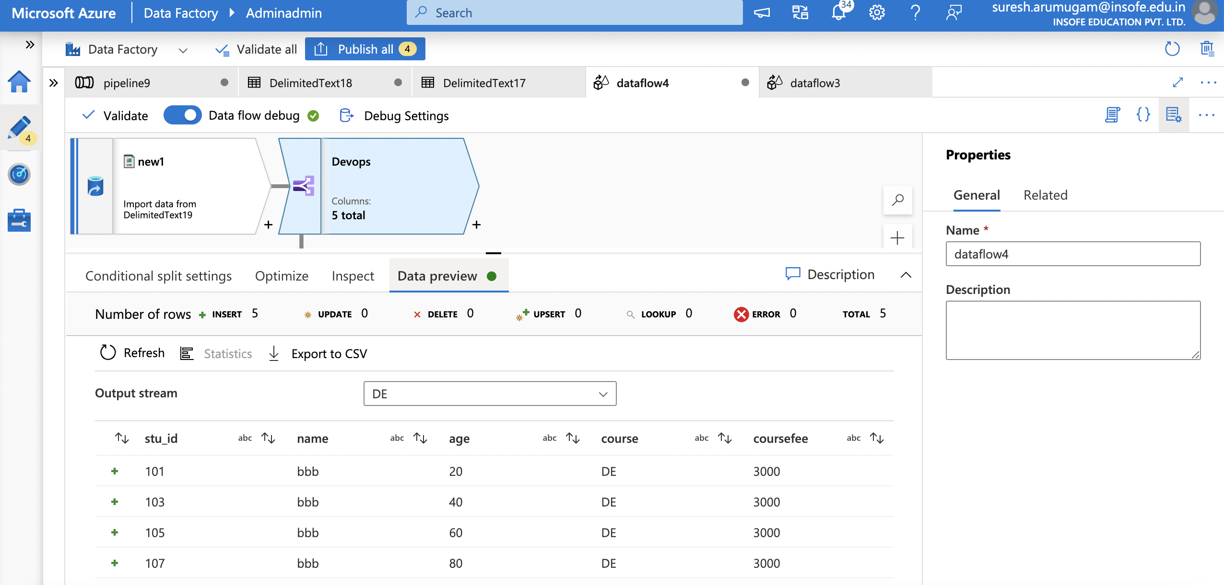
ADF – Transformation Activities

Slide 38
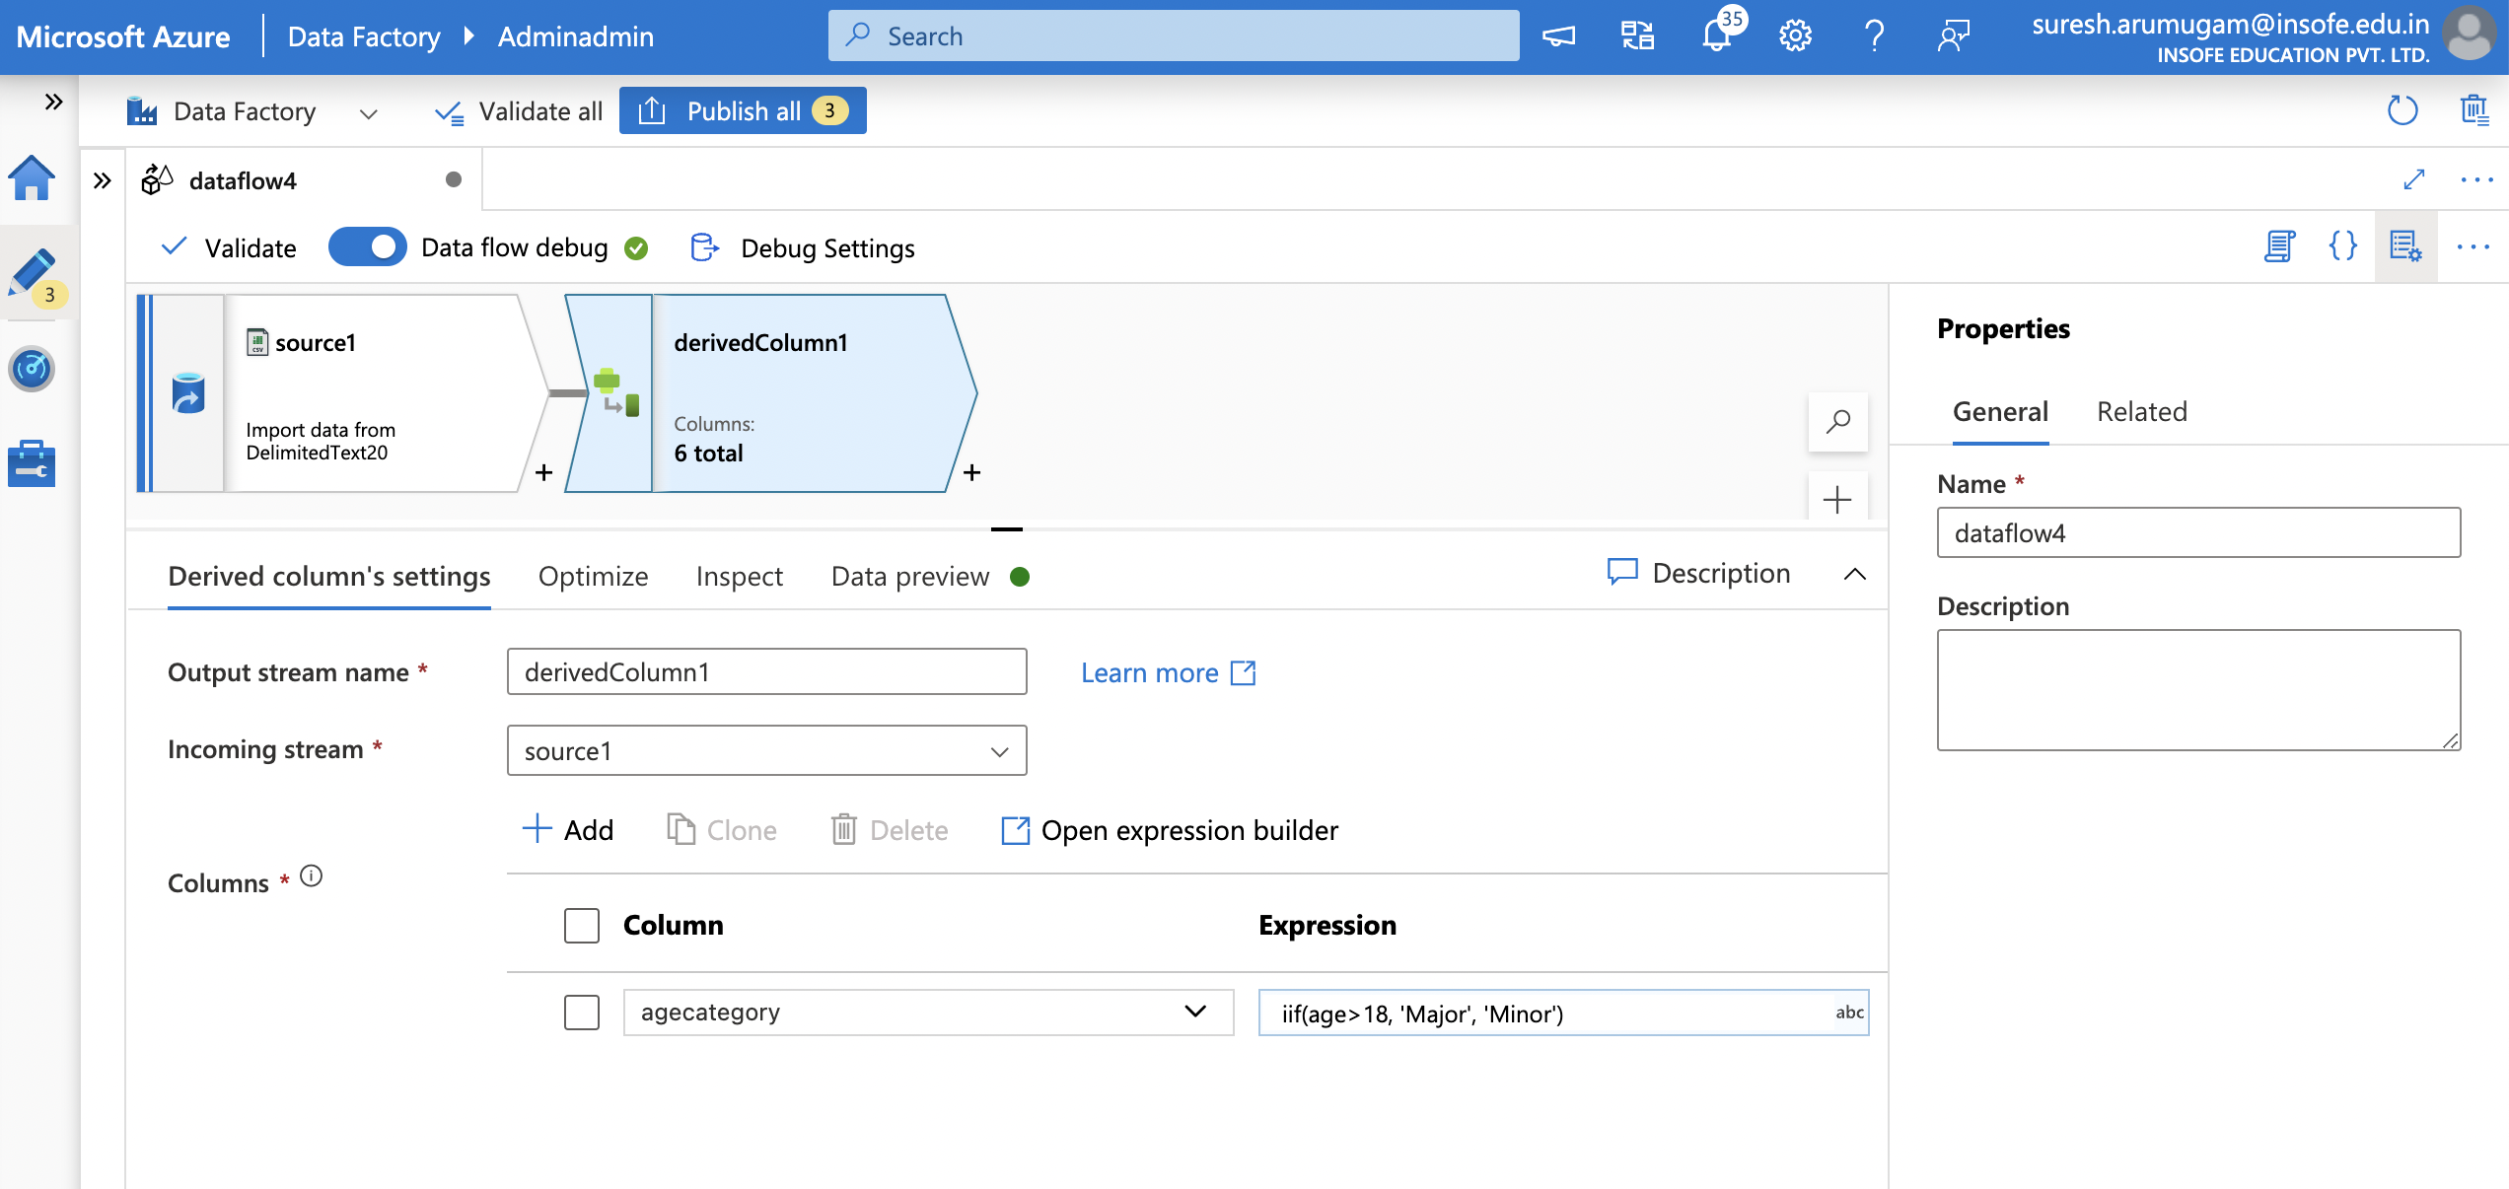
ADF – Transformation Activities

Slide 39
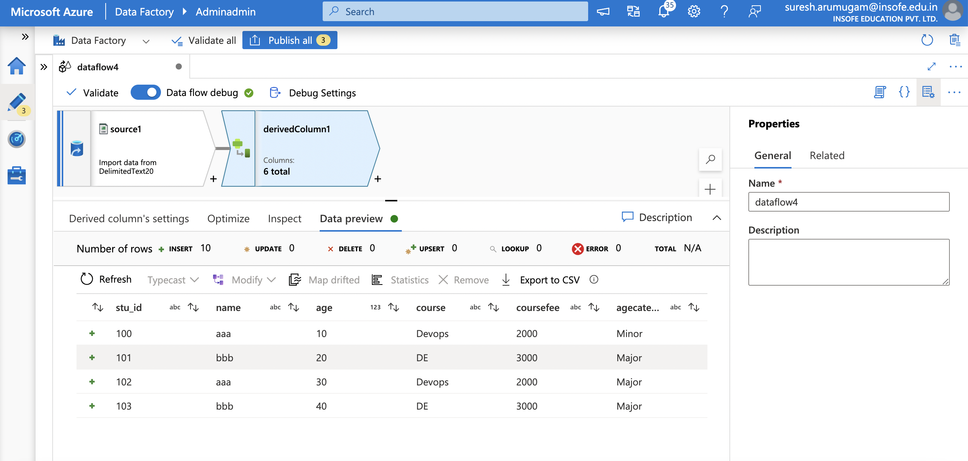
ADF – Transformation Activities

Slide 40
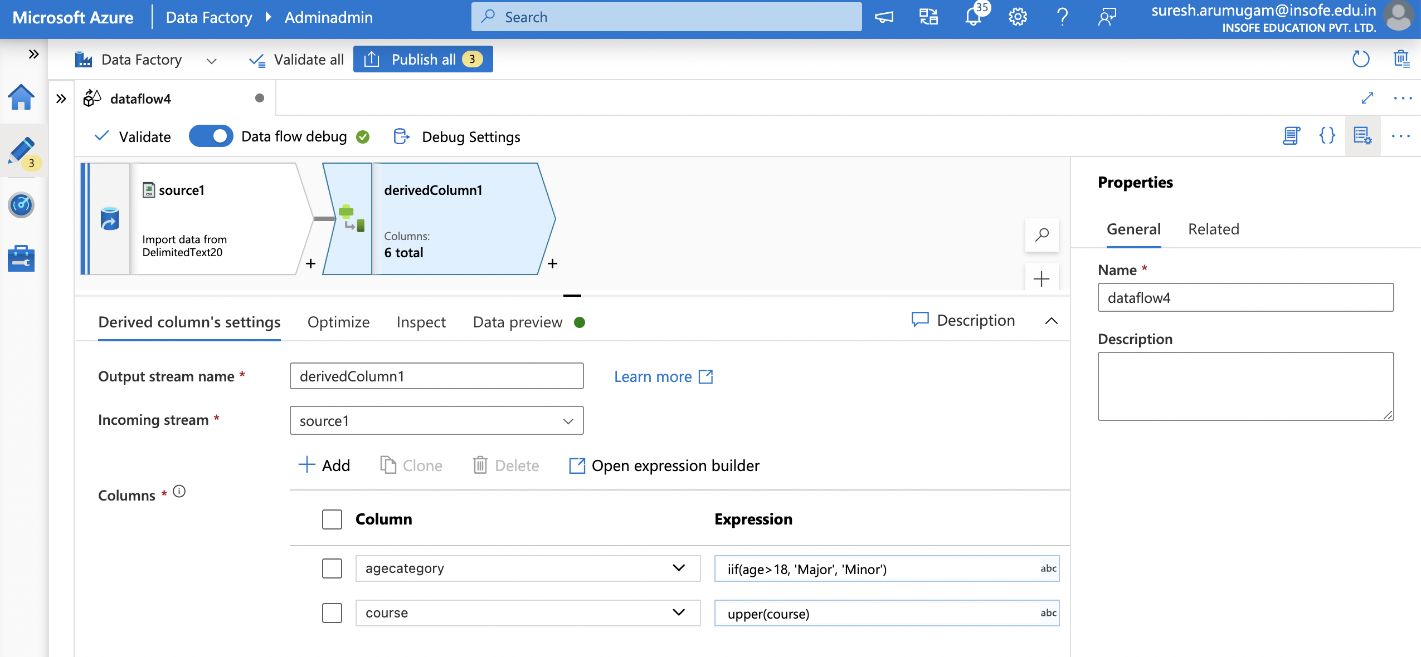
ADF – Transformation Activities

Slide 41
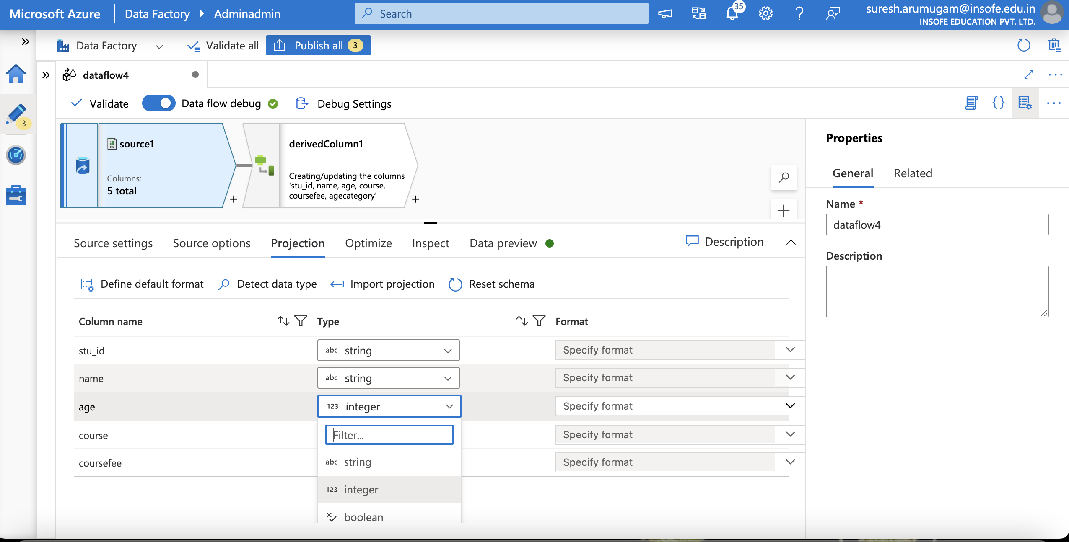

Slide 42
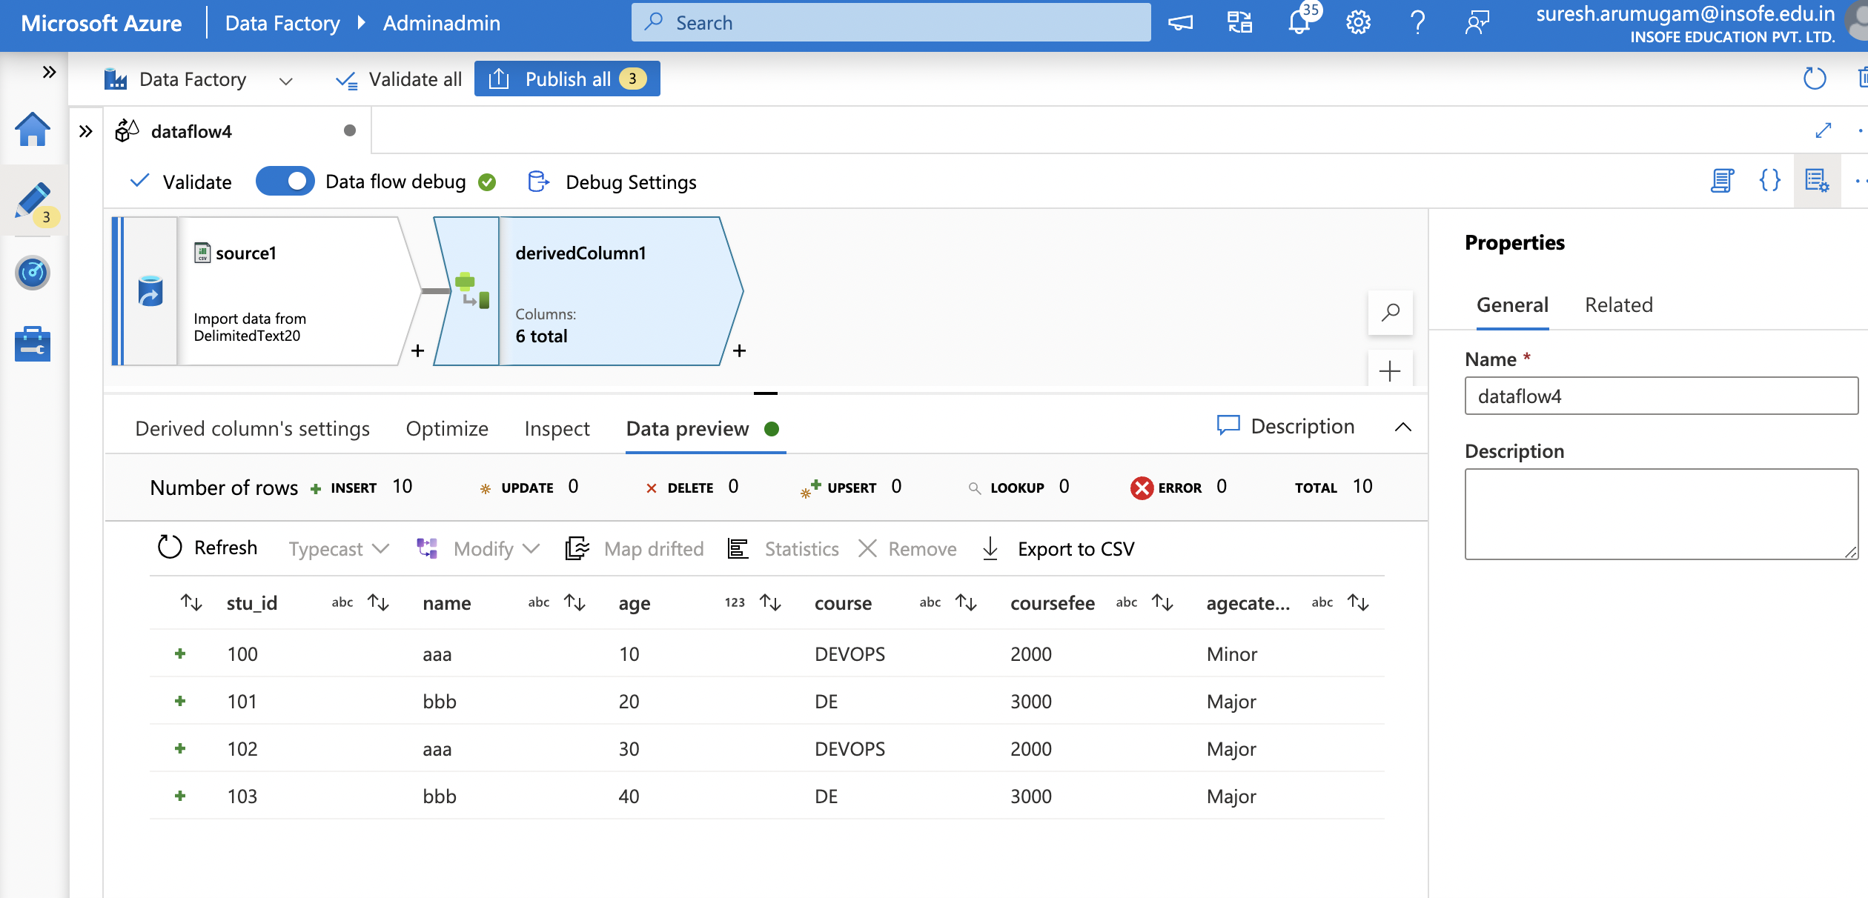
ADF – Transformation Activities

Slide 43
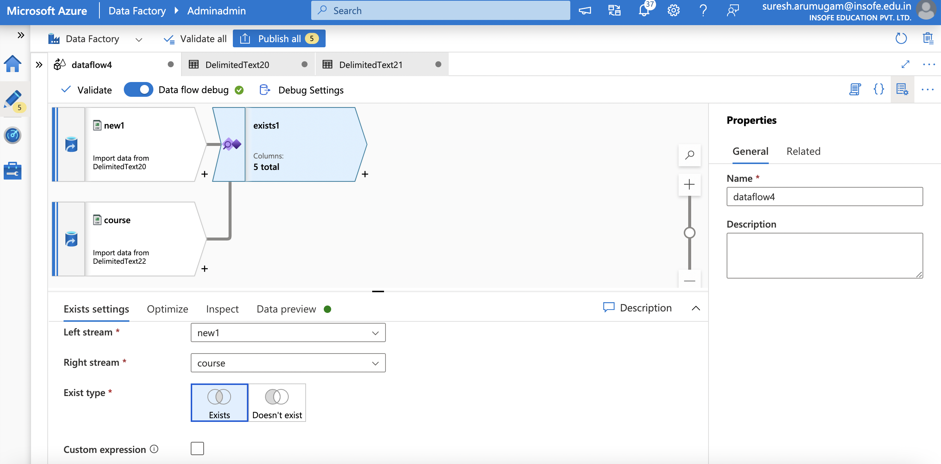
ADF – Transformation Activities

Slide 44
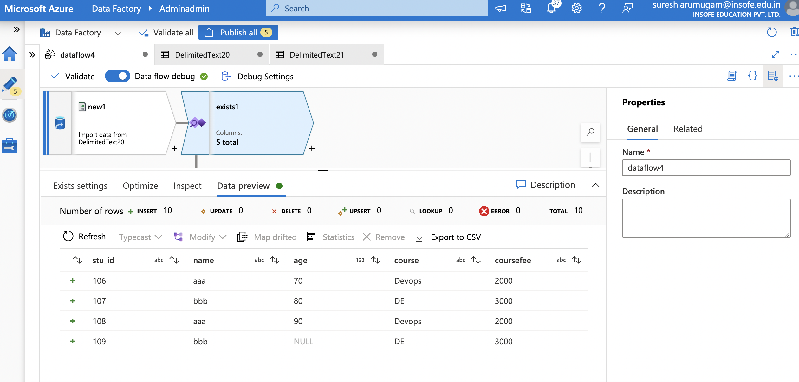
ADF – Transformation Activities

Slide 45
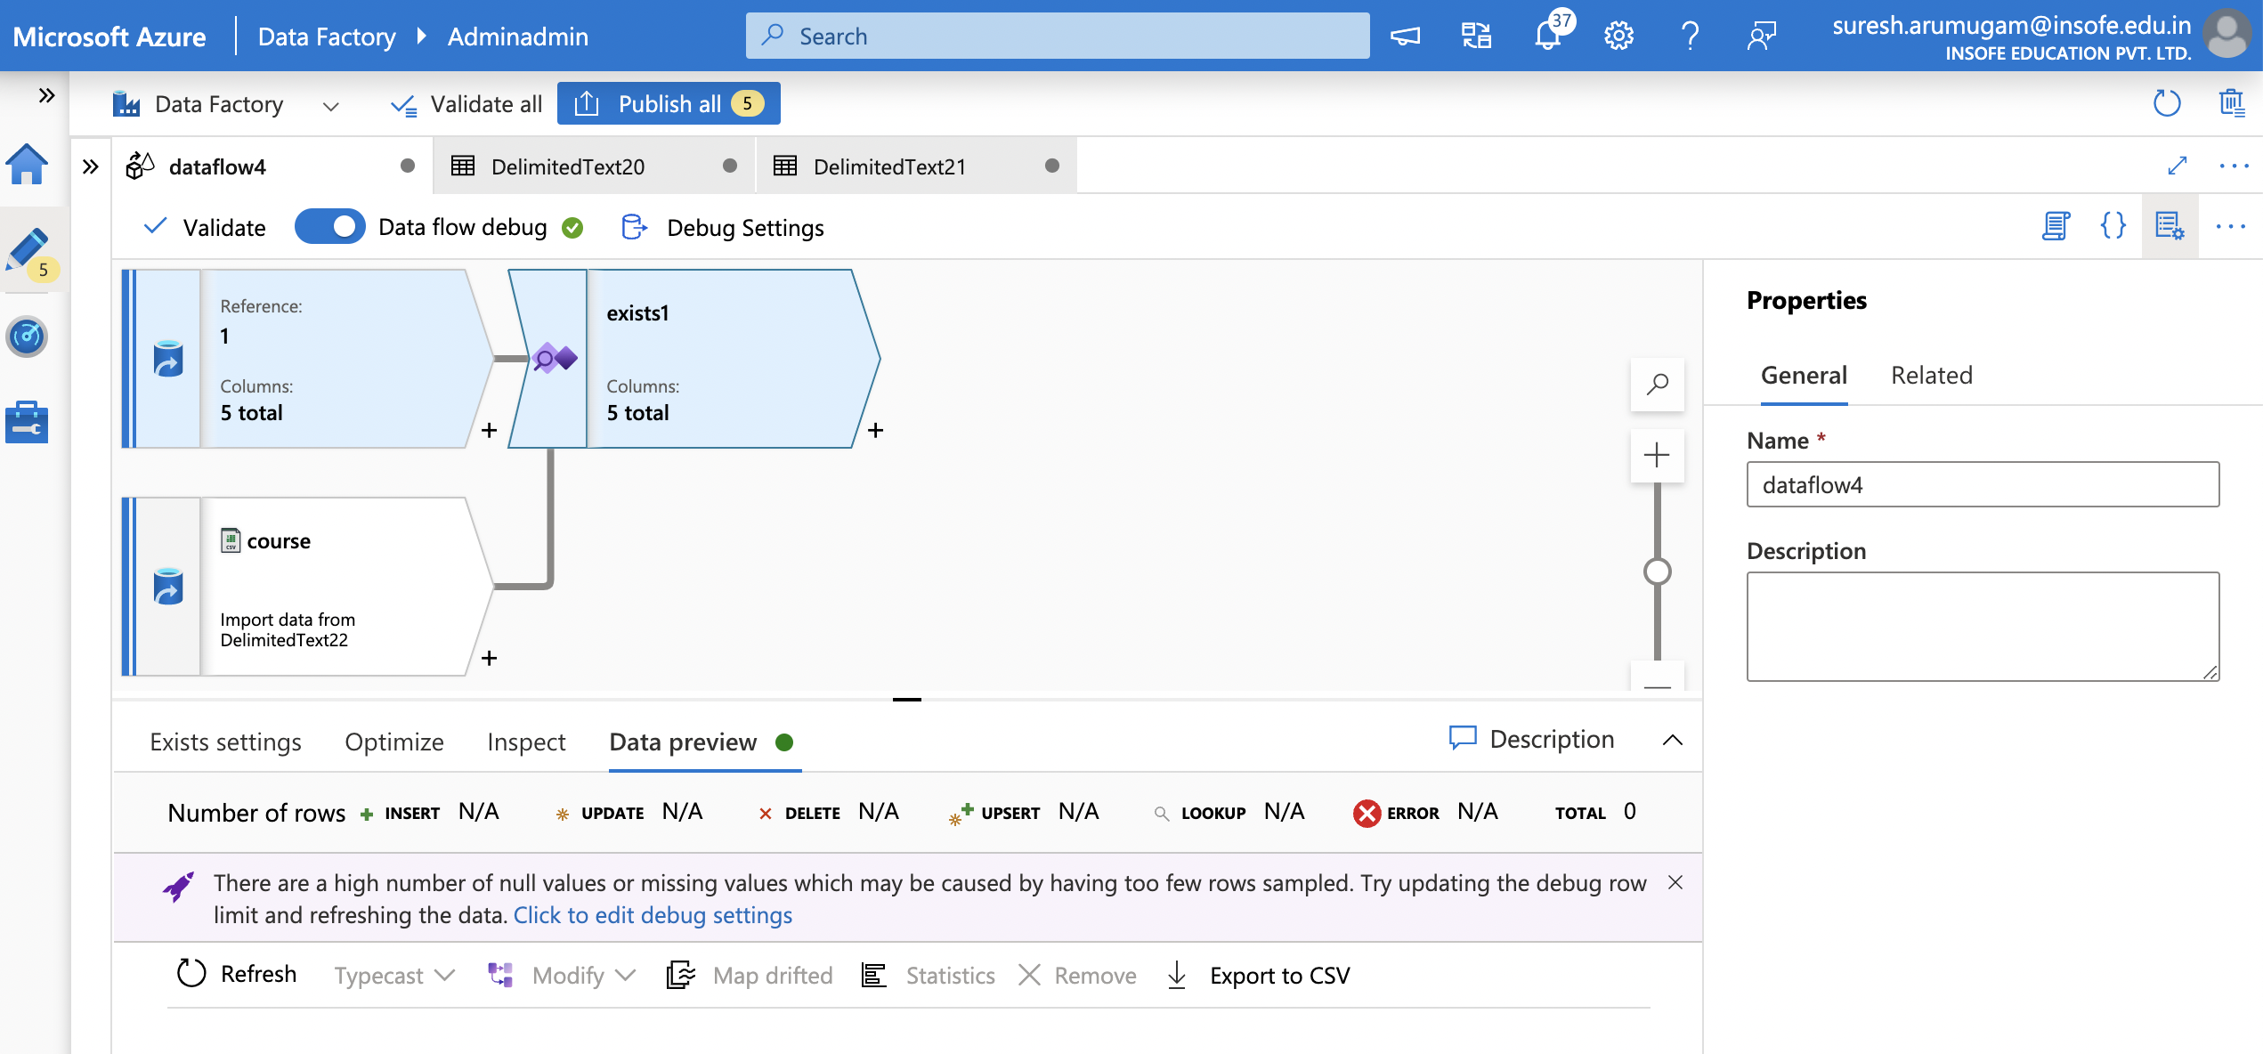
ADF – Transformation Activities

Slide 46
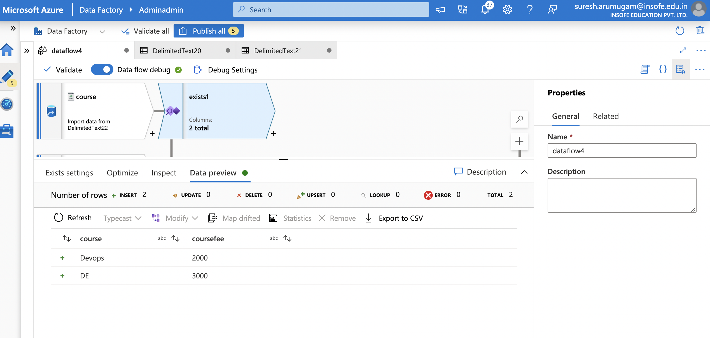
ADF – Transformation Activities

Slide 47
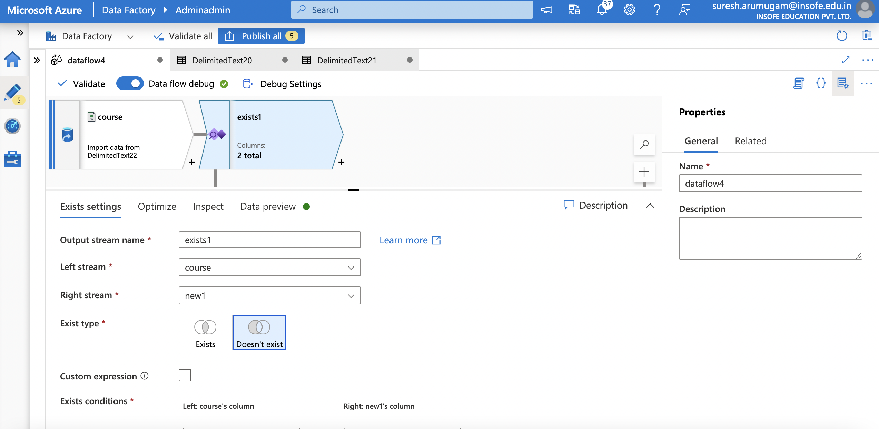
ADF – Transformation Activities

Slide 48
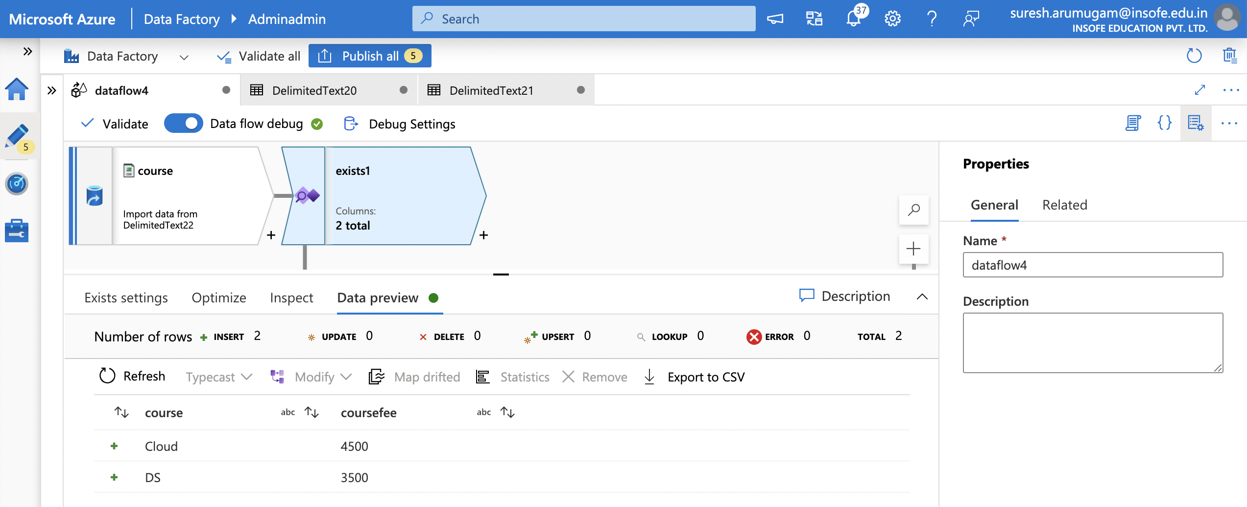
ADF – Transformation Activities

Slide 49
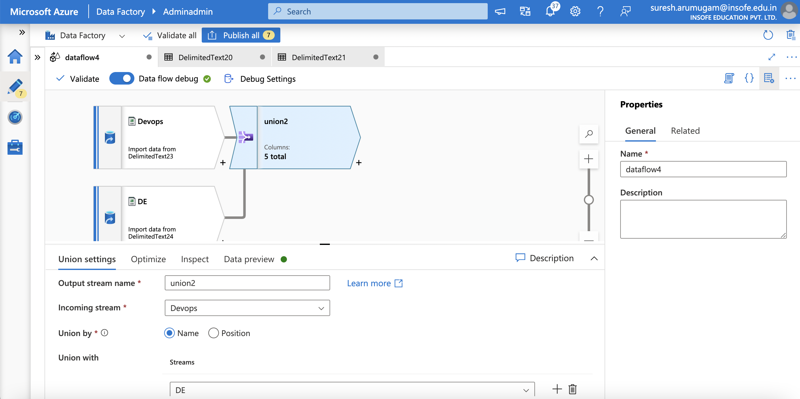
ADF – Transformation Activities

Slide 50

ADF – Transformation Activities

Slide 51


ADF – Transformation Activities

Slide 52

ADF – Transformation Activities

Slide 53

ADF – Transformation Activities

Slide 54

ADF – Transformation Activities

Slide 55

ADF – Transformation Activities

Slide 56

ADF – Transformation Activities

Slide 57

ADF – Transformation Activities

Slide 58

ADF – Transformation Activities

Slide 59

ADF – Transformation Activities

Slide 60

ADF – Transformation Activities

Slide 61

ADF – Transformation Activities

Slide 62

ADF – Transformation Activities

Slide 63

ADF – Transformation Activities

Slide 64

ADF – Transformation Activities

Slide 65

ADF – Transformation Activities

Slide 66

ADF – Transformation Activities

Slide 67

ADF – Transformation Activities

Slide 68

ADF – Transformation Activities

Slide 69

ADF – Transformation Activities

Slide 70

ADF – Transformation Activities

Slide 71

ADF – Transformation Activities

Slide 72

ADF – Transformation Activities

Slide 73

ADF – Transformation Activities

Slide 74

ADF – Transformation Activities

Slide 75

ADF – Transformation Activities

Slide 76

ADF – Transformation Activities

Slide 77
ADF – Transformation Activities
EXERCISE:
How to use parametrization in Dataflows?

Slide 78

ADF – Transformation Activities

Slide 79

ADF – Transformation Activities

Slide 80

ADF – Transformation Activities

Slide 81

ADF – Transformation Activities

Slide 82

ADF – Transformation Activities

Slide 83

ADF – Transformation Activities

Slide 84

ADF – Transformation Activities

Slide 85

ADF – Transformation Activities

Slide 86

ADF – Transformation Activities

Slide 87


Q&A ?

